Slide 1
ICS Forms and Functions
Seminar Series
Operations Section
March 13, 2021 PAC-3IM Reserve IMAT

Slide 2

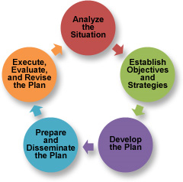
Overview
This course is designed to bridge the gaps between ICS 300, ICS 400, and position specific training – providing an overall awareness the responsibilities, tools, and nuances of each major position/role within the Incident Command System.
This training series is designed to be used as a supplement to NIMS All-Hazard training, position qualification task books, job aids, and the Incident Management Handbook as we progress from seminar to tabletop (TTX) to full-scale (FSE) exercises.
Notes:
From a training and execution standpoint, it is just as important to know what the person beside you is expected to do as the details of what you are supposed to do. This allows for efficiencies of the system to be realized with members performing their piece in a focused manner, trusting that what is not their direct responsibility is still getting done.

Slide 3
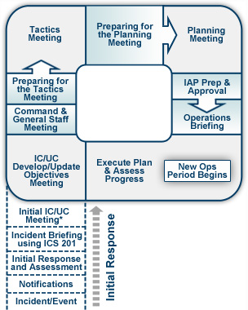
Overview
ICS is both an organizational structure and a process; follow the ICS structure flexibly but follow the ICS process rigidly.
Common Terminology
Integrated Communications
Modular Organization
Unified Command Structure
Manageable Span of Control
Consolidated Action Plans
Comprehensive Resource Management
Agency Inter-Operability
Notes:
It is imperative that incident commanders and all assigned personnel have the knowledge of the system and proficiency with their roles as assigned by position. This enables members to perform as a team and trust in the process.
The organizational structure is meant to adapt to the needs of the incident.
The process, however, is what makes the system effective between agencies because of its “common language” and formalized process, especially the planning process, which is proven to be highly effective in an interagency effort.
The ICS process does not eliminate the requirement to make difficult decisions but provides a structure and process to make well informed decisions. About 80% of a response structure, including overarching decisions and objectives is common between response types. The remaining 20% of each IAP will be incident specific requiring more focused IC/UC collaboration.

Slide 4
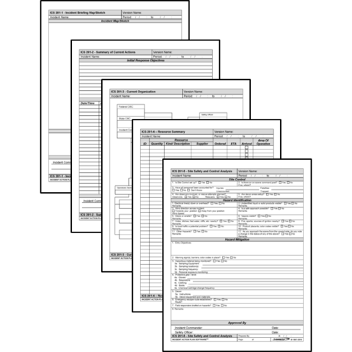
Introduction to Forms
The ICS forms are valuable tools that can be used to:
Gather and disseminate information
Develop a common operational picture and situational awareness
Provide a comprehensive understanding of incident status, intended objectives, and resource utilization
Assist in building the IAP in conjunction with and supporting the planning process
Account for all participants operating at the incident
Ensure there is a legal and historical record of the event
Notes:
ICS forms are valuable tools to assist in developing a simple plan that can be communicated through briefings.
Using ICS forms to gather information provides a template for strategic, operational, and tactical planning

Slide 5
Forms: Coast Guard / FEMA
ICS Form: | Form Title: | Typically Prepared By:
ICS 201 | Incident Briefing | Initial Incident Commander
ICS 202 | Incident Objectives | Planning Section Chief
ICS 202A | Command Direction | Planning Section Chief
ICS 202B | Critical Information Requirements | Planning Section Chief
ICS 203 | Organization Assignment List | Resource Unit Leader and Operations Section Chief
ICS 204 | Assignment List | Resource Unit Leader / Operations
ICS 204A | Assignment List Attachment | Resource Unit Leader / Operations
ICS 205 | Incident Radio Communications Plan | Communications Unit Leader
ICS 205A | Communications List | Communications Unit Leader
ICS 206 | Medical Plan | Medical Unit Leader / Safety Officer
ICS 207 | Incident Organizational Chart | Resource Unit Leader
ICS 208 | Site Safety Plan | Safety Officer
ICS 209 | Incident Status Summary | Situation Unit Leader
ICS 210 | Resource Status Change | Communications Unit Leader
ICS 211 | Incident Check-In List | Resource Unit Leader
ICS Form: | Form Title: | Typically Prepared By:
ICS 211A | Sign-in Worksheet | Resource Status / Check-In Recorder
ICS 213 | General Message | Any Message Originator
ICS 213RR | Resource Request | Any Resource Requestor
ICS 214 | Activity Log | All Sections and Units
ICS 214A | Chronology of Events Log
ICS 215 | Operational Planning Worksheet | Operations Section Chief / Resource Unit Leader
ICS 215A | Incident Action Plan Safety Analysis | Safety Officer
ICS 219-1 to 219-10 | Resource Status Cards (T-Cards) | Resource Unit Leader
ICS 220 | Air Operations Summary Worksheet | Operations Section Chief / Air Branch
ICS 221 | Demobilization Check-Out | Demobilization Unit Leader
ICS 225 | Incident Personnel Performance Rating | Supervisor at the Incident
ICS 230 | Meeting Schedule | Planning Section Chief
ICS 233 | Open Action Tracker | Situation Unit / Planning Section
ICS 234 | Work Analysis Matrix | Operations Section
ICS 239 | Incident Complexity Analysis | Incident Commander

Slide 6
Forms: Incident Support / Other
ICS Form: | Form Title: | Typically Prepared By:
ICS 300 to ICS 330 | Area Command Formatted Series | Area Commands
ICS 232 | Resources At Risk Summary | Environmental Unit Leader
ICS 232A | ACP Site Index | Environmental Unit Leader
ICS 235 | Facilities Needs Assessment | Facility Unit Leader
ICS 236 | Tentative Release List | Demobilization / Resource Unit Leaders
ICS 237 | Mishap Reporting Worksheet | Operations / Safety
ICS 238 | Demobilization Tracking Table | Demobilization Unit Leader
ICS 240 | Information Management Plan | Situation Unit Leader / LOFR
ICS 261 | Incident Property Tracking Worksheet | Logistics
ICS Form: | Form Title: | Typically Prepared By:
ICS 216 | Radio Requirements Worksheet | NFES
ICS 217 | Radio Frequency Worksheet | NFES
ICS 218 | Support Vehicle/Equipment Inventory | NFES
ICS 224 | Crew Performance Rating | NFES
ICS 226 | Individual Personnel Rating | NFES
 | Demobilization Plan | Demobilization Unit Leader
 | Facility Plan | Facility Unit Leader
 | Transportation Plan | Facility Unit Leader
 | Food Plan | Food Unit Leader
 | IAP Cover Sheet | Resource Unit Leader
 | Safety Messages | Safety Officer
 | GAR-II | Operations Section Chief / DIVS / Safety Officer
Coast Guard forms will have a “CG” behind the numbers

Slide 7
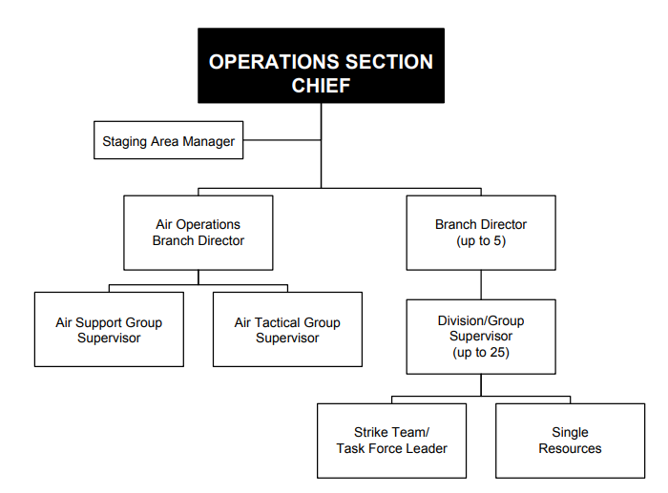
Operations Section
The Operations Section must concurrently support both
Current Operations and the Planning Process for
Future Operations
Notes:
The Operations Section Chief (OSC) is responsible for the management of tactical operations directly in support of the primary mission. The OSC is normally selected from the organization with the most jurisdictional or functional responsibility for the incident, however, they are rarely, if ever, working alone.
Together with:
Safety Officer: Conduct operations risk management evaluation and ensure on-scene personnel execute work assignments following approved safety practices
Planning Section: selection of appropriate strategies and tactics to accomplish incident objectives, and conduct resource needs assessment
Liaison Officer and Agency Reps: Maximize effectiveness of the mission by using multi-agency resources and response capabilities
Incident Command: Supports the creation of critical information requirements (CIR) to meet operational execution needs.
Maritime Transportation / MTS Recovery: establish task-specific functional groups such as wreck identification, salvage response, decontamination, and vessel queue management.
In some instances, the OSC may be the designated SAR Mission Controller (SMC); however, separate individuals should carry out the OSC and SMC functions if the operational tempo and/or span of control warrant it. If the OSC is also the SMC then the SMC responsibilities apply in addition to the standard OSC responsibilities.
It is critical for the OSC to remain focused on the overall requirements of the incident. It is not possible for a single person to do this in a complex incident. The use of Deputies, Assistants, or Branch Support personnel located at the ICP will exponentially expand the capacities of the Operations Section by allowing dedicated resources to stay focused on management of current operations, and then a different resource to actively engage in the Planning Process. Strengths of the overall team and experience of the Section Chief will dictate the best staffing model for the section.

Slide 8
Operations Section - OPBD
Operations Branch Directors (OPBD) are a critical resource in complex incidents in order to maintain adequate span of control.
Branches can be organized functionally or geographically
Notes:
The Operations Branch Directors are under the direction of the OSC and responsible for the implementation of the portion of the IAP appropriate to the Operations Branch when activated.
Primary responsibility is to identify and manage Divisions, Groups, and resources assigned to the Operations Branch.
In addition, they
provide the OSC alternative or contingency strategies and tactics
communicate requirements for additional or changing resource needs
provide support to the Staging Areas
approve accident or medical reports
Resolve logistic problems across the section

Slide 9
Operations Section - DIVS
Division/Group Supervisors (DIVS)
Division: geographical areas of operation
Group: functional areas of operation
Strike Team: same kind/type of
resources w/ common
comms and a unit leader
Task Force: resources w/ common
comms and unit leader,
assembled for specific mission
Single Resource: an individual,
a crew or team, a piece of
equipment and its operator
Notes:
The Division or Group Supervisor is the team lead, responsible for communications with and the safety of all assigned resources.
Tasked with executing operational assignments as directed in the ICS-204’s
Assemble and demobilize task force/strike teams as appropriate
Supervise Division/Group resources and make changes as appropriate
Coordinate activities with adjacent Division/Group
Submit situation status and resource status back to the planning support function of Ops
Report any hazardous situations, mishaps, or changing conditions
Resolve logistical problems within the division/group

Slide 10
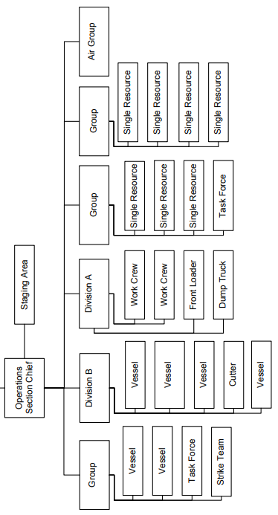
Operations Section - DIVS
Notes:
Expanded Org Chart to demonstrate multiple Divisions and Groups under a single Section Chief

Slide 11
Operations Section - AOBD
Air Ops Branch Director (AOBD)
ICS-220-CG: Air Operations Summary
Air Tactical Group: coordination of aircraft operations – similar to airborne SAR On-Scene Commander
Air Support Group: supporting
aircraft and crews (fuel,
Maintenance, safety, records)
Notes:
The creation of an Air Operations Branch should be considered if the number of air resources exceeds what could be assigned to an Air Operations Group.
The AOBD is ground-based and primarily responsible for preparing the Air Operations Summary (ICS 220-CG) and the air operations portion of the IAP, and for providing logistical support and direction to aircraft and personnel supporting incident response.
The Air Ops Branch is the only unit under the Operations Section responsible for creating and maintaining their own form.
The Air Operations Summary (ICS 220-CG) serves a similar purpose as the Assignment List (ICS 204-CG) by assigning and managing aviation resources on the incident.
The AOBD liaises with air stations and other agencies that are providing aircraft and aircrews to the incident. Effective coordination with assisting air stations is particularly important when an Air Operations Branch desires to fly an aircrew made up of personnel from different organizations.
The AOBD will ensure that organization directives, safety protocols, flight manuals, and unit restrictions, will not be violated by incident response aircraft (e.g., flight hours, hoist limitations, and night flying).
Implement FAA air space closure and air space deconfliction plans to conduct operations as required.
Oversee creation of air task orders or flight schedules to mitigate safety risk of aircraft operations in confined or saturated air space.
Coordinate airspace use with the FAA.
Request declaration or cancellation of Temporary Flight Restrictions (TFRs) in accordance with applicable Federal Aviation Regulations and post Notice to Airmen (NOTAM).
Report safety concerns, special incidents, and accidents to the SOFR.
Evaluate helibase and helispot locations.
Also available to the Operations Section are technical specialists
Air Tanker / Fixed Wing Coordinator
Helicopter Coordinator
Helibase Manager
Helispot Manager

Slide 12
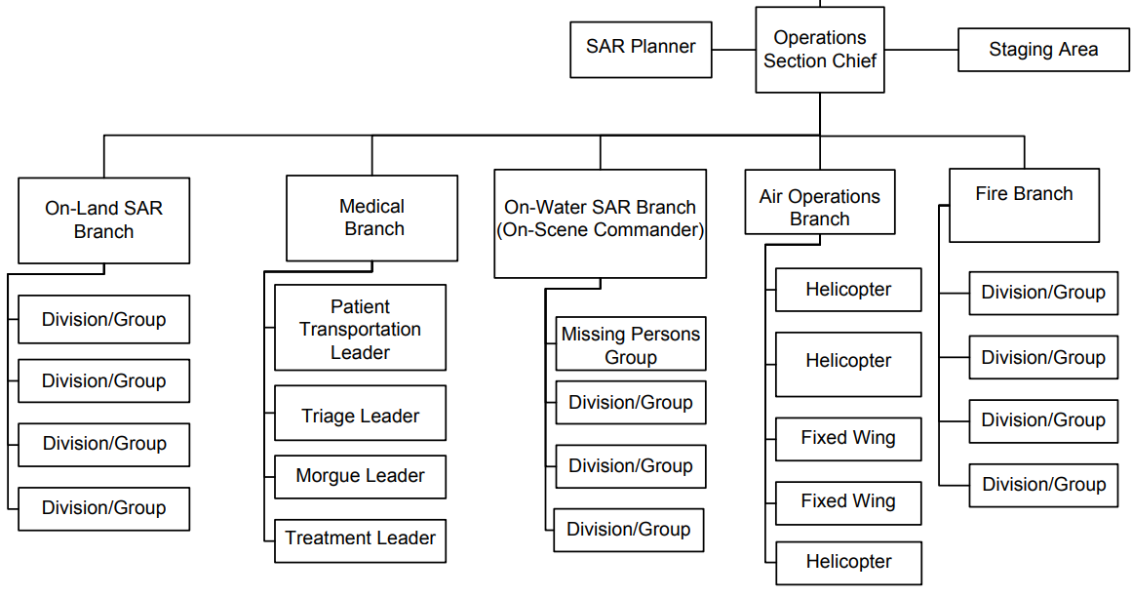
Operations Section – Complex Incident
Notes:
Expanded Org Chart to demonstrate multiple Branches activated under the Operations Section
Additional incident requirements could necessitate activation of:
Mass Fatality Management Coordinator.
Medical Group Supervisor
Triage Leader
Treatment Leader
Patient Transport Leader
Field Site/Recovery Coordinator.
Morgue/Postmortem Examinations Coordinator.
Victim Identification Coordinator.
Family Assistance Center Coordinator.
Quality Assurance Coordinator.

Slide 13
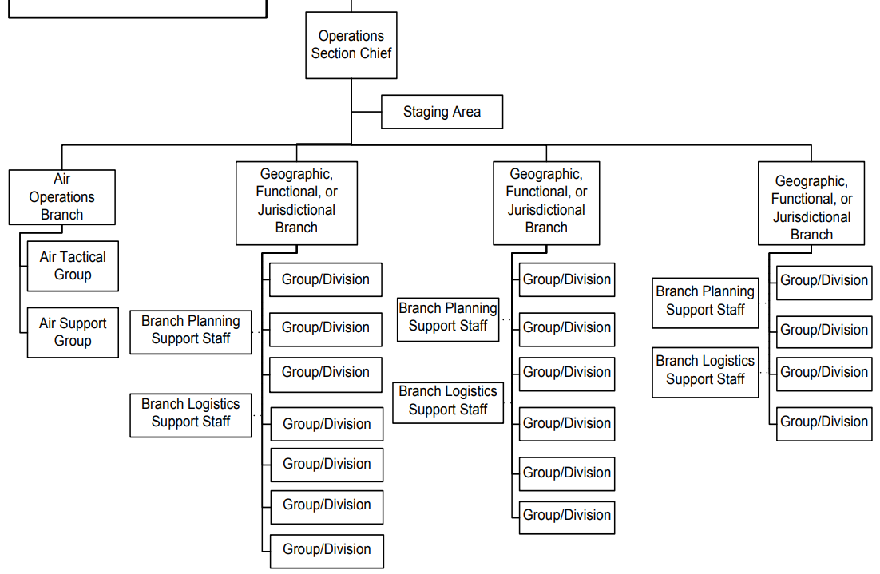
Operations Section – Support Staff
Notes:
Reminder - As the Operations Section continues to expand on complex incidents – it is important to staff the support and planning functions in addition to the branches, divisions, and groups

Slide 14
Operations Section - STAM
Staging Area Managers (STAM)
Must coordinate and collaborate with:
Operations – Planning
Operations – Current
Safety Officer
Liaison Network
Resource Unit
Supply Unit
Ground Support
Security Manager
Facilities Unit
Vessel Support
Technical Specialists
Food Unit
Notes:
In addition to storing unassigned equipment, Staging Areas are often combined with forward operating bases or will serve as a central point for receiving or distributing more than just equipment that has been assigned to the response. Often times the Staging Area is a meeting point for operational crews/teams and usually serves as a field location for joint operations. It is also a common location for the establishment of decontamination stations.
Design and layout of staging areas needs to be intentional, and expected traffic volume and timing monitored. If too busy or the needs of the space outgrow the designated area, either certain functions need to be assigned a different facility, or staging areas need to be expanded to handle all of the competing needs of the space.
A Site Safety Manager may be assigned by the Safety Officer as a permanent on-site assistant.

Slide 15
ICS-234 Work Analysis Matrix
 |  |  | WORK ANALYSIS MATRIX ICS 234-CG
1. Incident Name |  | 2. Operational Period From: To:
3. Operation’s Objectives DESIRED OUTCOME | 4. Strategies HOW |  |  | 5. Tactics/Work Assignments WHO, WHAT, WHERE, WHEN
Another purpose of the ICS-234 is that it presents alternative (or what-if) strategies and tactics to respond to bad weather, sudden changes in operational conditions, etc.
Notes:
WORK ANALYSIS MATRIX FORM INSTRUCTIONS (ICS FORM 234-CG) Rev. 8/05
Purpose. The Work Analysis Matrix is designed to help select the best strategies and tactics to achieve the operational objectives. This optional form assists staff in carrying out incident objectives by outlining the who, what, where, when, and how of the response. The tactics from this form carry forward to the “Work Assignment” on the ICS-215.
This form is simply a formalized version of how most OSCs tend to think in order to turn objectives into tactical field work.
Preparation. The Work Analysis Matrix, if used, is usually completed by the Operations Section Chief and Planning Section Chief prior to the Tactics Meeting.
Distribution. All completed original forms must be submitted to the Documentation Unit.

Slide 16
ICS-234 Work Analysis Matrix
 |  |  | WORK ANALYSIS MATRIX ICS 234-CG
1. Incident Name |  | 2. Operational Period From: To:
3. Operation’s Objectives DESIRED OUTCOME | 4. Strategies HOW |  |  | 5. Tactics/Work Assignments WHO, WHAT, WHERE, WHEN
Control the source of the spill | Pipeline Owner responsible for stopping flow of hazardous liquid and for repairs to the damaged pipe. Ensure they have secure and open access to complete repair work Monitor repair process for any incidents that may cause additional release in to the water |  |  | traffic safety team to keep repair area clear and allow unrestricted access to repair equipment and monitor for any security issues Field Observer to monitor repair work and report back immediately if there are any setbacks in repair work
Keep the Public and Stakeholders Informed of Response Activities | Ensure PIO network and LOFR Network are active and have everything they need to control incident communications Ensure field crews are reporting all information up to the ICP in a timely manner |  |  | Add CIR’s and media schedule deadlines for reporting on-scene information to the message section of the work assignments reiterate that field crews should not be talking to the media without approval provide information on where to direct inquiries (JIC)
Objectives come directly from the ICS 202 Incident Objectives Form
Important to keep exact wording of objective so it is clear what problem you are trying to address.
Notes:
Early in the incident it is important to identify all incident objectives on to the work analysis form, even if they are not under your area of responsibility.
This helps identify what objectives are Operational Objectives, and what are Management Objectives, as well as what Objectives need to be claimed by other team member. It communicates that nothing was left out of the analysis process, which is important for teams who are less familiar with each other and may not have the inherent trust that comes with working a couple operational periods with the same team.
It also provides feedback on how well or poorly the incident objectives are by providing a visual translation from objective to tactic. Newer Planning Section Chiefs and or Incident Commanders may not yet have extensive experience with the development of SMART objectives.

Slide 17
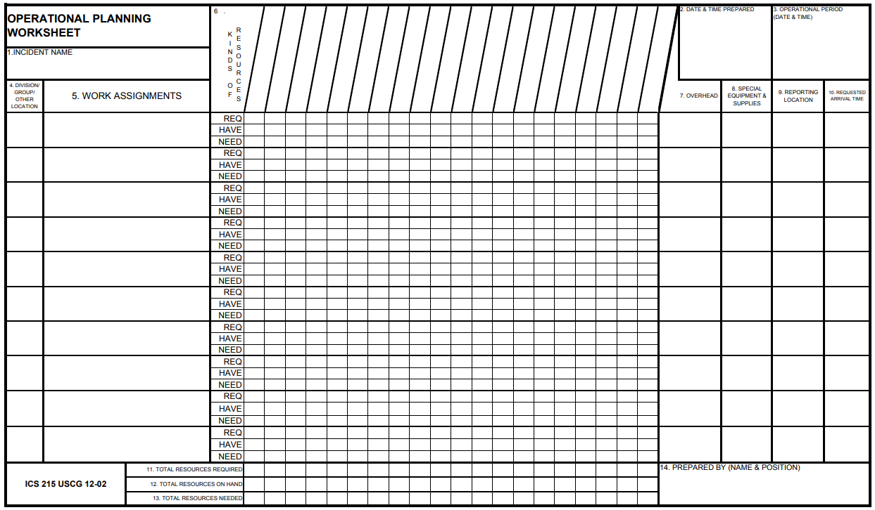
ICS-215 Operational Planning Worksheet
The ICS 215 is available as a PDF or as an Excel Workbook
Yellow boxes represent areas of
the form enlarged
on next slide

Slide 18
ICS-215 Operational Planning Worksheet
OPERATIONAL PLANNING WORKSHEET |  | 6.
 |  | KINDS OF RESOURCES
1.INCIDENT NAME
4. DIVISION/ GROUP/ OTHER LOCATION | 5. WORK ASSIGNMENTS
Shoreside Support | keep pipe repair area clear and allow unrestricted access to repair equipment, monitor for security | REQ | 3
 |  | HAVE | 2
 |  | NEED | 1
Shoreside Support | FOB monitor repair work and report back immediately if there are any setbacks in repair work | REQ |  | 1
 |  | HAVE |  | 1
 |  | NEED |  | 0
 | 2. DATE & TIME PREPARED |  | 3. OPERATIONAL PERIOD (DATE & TIME)
 | 7. OVERHEAD | 8. SPECIAL EQUIPMENT & SUPPLIES | 9. REPORTING LOCATION | 10. REQUESTED ARRIVAL TIME
 |  | LE Units | Main spill location at Nutmeg Pipeline | 0800
 |  | Radio | Main spill location at Nutmeg Pipeline | 0800
Traffic Control Unit - CSO
Field Observer

Slide 19
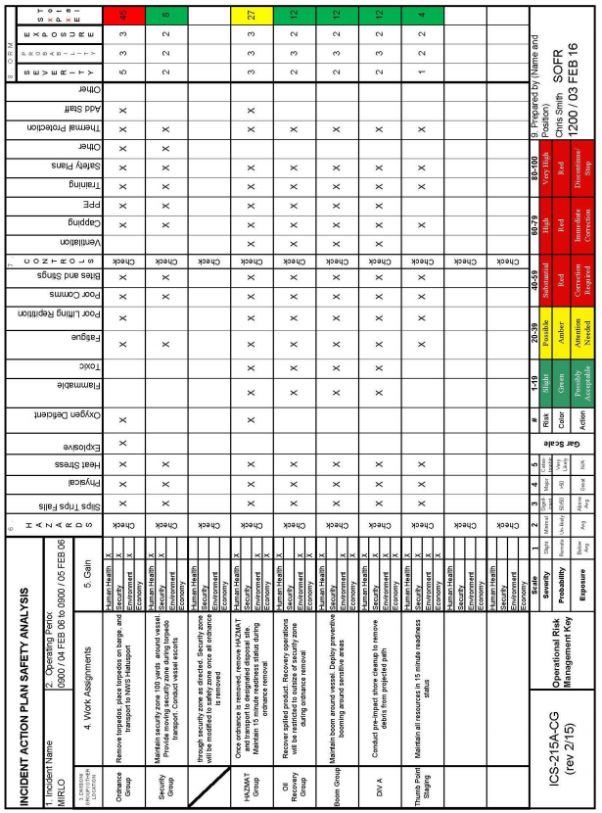
ICS 215A: Incident Action Plan Safety Analysis
This sheet mirrors the ICS 215 Operations Planning Worksheet
SOFR completes the ICS-215A Incident Action Plan Safety Analysis alongside the OSC during the creation of the ICS-215
Notes:
ICS-215A Incident Action Plan Safety Analysis form is used to:
Produce an operational risk assessment in order to prioritize hazards, safety, and health issues, and develop appropriate control
Enable Command and General staff to form a complete picture in anticipation of planned operational activities
Purpose: The purpose of the Incident Action Plan Safety Analysis (ICS‑215A) is to aid the Safety Officer in completing an operational risk assessment to prioritize hazard, safety, and health issues, and to develop appropriate mitigations. This worksheet is best used in the planning phase to identify safety concerns for all operational assignments.
Preparation: The ICS-215A is typically prepared by the Safety Officer during the incident action planning cycle. When the Operations Section Chief is preparing for the Tactics Meeting, the Safety Officer collaborates with the Operations Section Chief to complete the form. This form is closely linked to the Operational Planning Worksheet (ICS-215).
Work assignments are listed along with associated hazards. A calculation is made that determines what level of risk each work assignment poses. For those assignments having significant risk, controls are developed for safeguarding responders. The net risk is evaluated against the gain. The Incident Commander should be alerted to all safety hazards that receive high risk rating (e.g. red) after controls have been established.
Distribution: When the safety analysis is completed, the form is distributed to the Resources Unit to help prepare ICS-204 forms for each Branch, Division, and Group.
The Operational Hazard Worksheet is attached to the Incident Site Safety Plan and is distributed according to the instruction for Site Safety Plans.
All completed forms must be given to the Documentation Unit in the Planning Section.

Slide 20
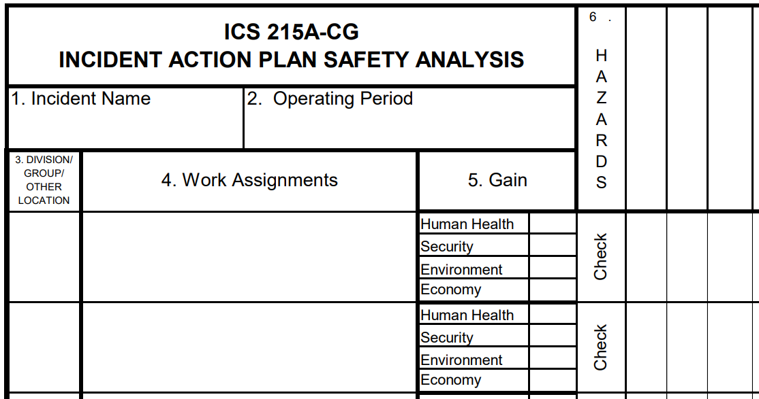


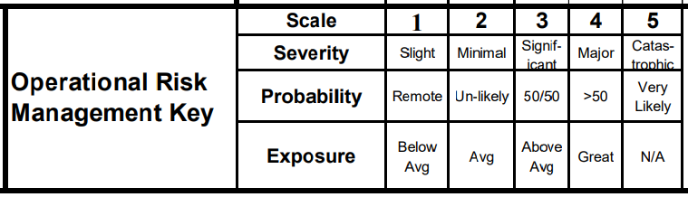
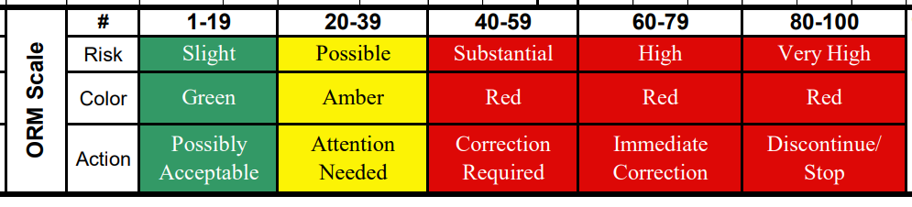
ICS 215A: Incident Action Plan Safety Analysis
Sun block / shade
Moving Vehicle
Steel toe boots
Machinery
Sun Exposure
keep pipe repair area clear and allow unrestricted access to repair equipment, monitor for security
X
X
X
X
2
4
2
16
X
FOB monitor repair work and report back immediately if there are any setbacks in repair work
X
X
X
X
1
4
2
8
X
Notes:
Gain Check the gain that is achieved when the work assignment is accomplished. There MUST be a gain if personnel will be put at risk.
Hazards Using the IAP Safety Analysis Aid (next slide), list the type of hazards likely to be encountered for the work assignment. Place a check mark in the box below the hazard.
Controls Using the IAP Safety Analysis Aid (next slide), list the type of controls likely to be used for addressing the hazards listed. Place a check mark in the box below the control.
ORM Using the "Key", assign a number from 1 to 5 based on the level of severity, probability and exposure. Multiply all numbers together to get a total. Enter this number into the total column. Using the scale on the bottom of the sheet, assign a color, risk level or action phrase in this block.
Alternatively, the Coast Guard GAR-II form can be used to identify Operational Risk Management needs

Slide 21
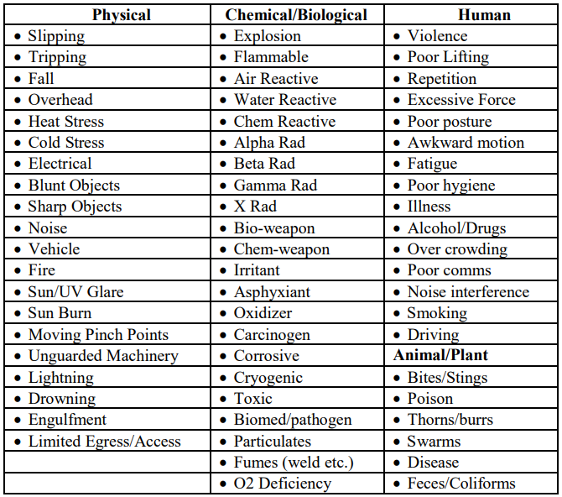
ICS 215A: Incident Action Plan Safety Analysis
HAZARDS

Slide 22
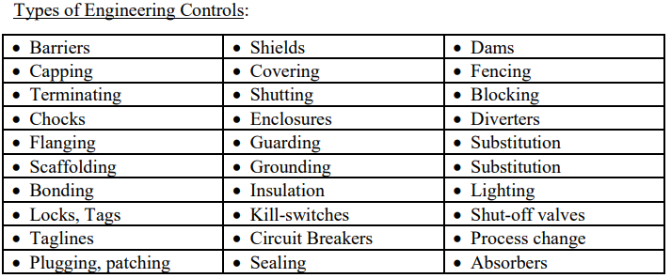
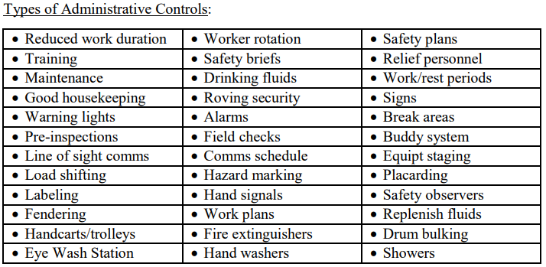
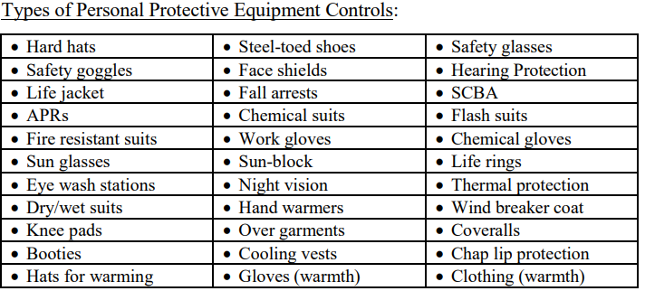
ICS 215A: Incident Action Plan Safety Analysis
CONTROLS

Slide 23
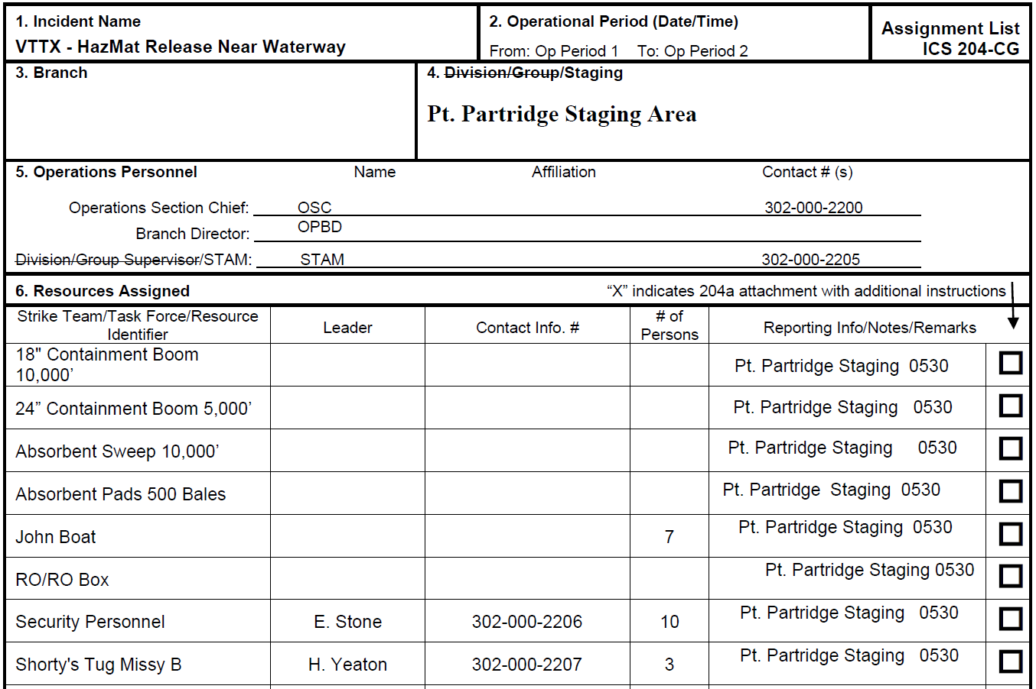
ICS 204 Work Assignments
Boxes 1-5 can be completed by anyone collaborating on the form
Box 6: Resources Assigned
Information provided by RESL
X
Notes:
Purpose. The Assignment List(s) informs Division and Group supervisors of incident assignments. Once the Unified Command and General Staff agree to the assignments, the assignment information is given to the appropriate Divisions and Groups.
Preparation. The Assignment List is normally prepared by the Resources Unit, using guidance from the Incident Objectives (ICS 202-CG), Operational Planning Worksheet (ICS 215-CG), and the Operations Section Chief.
The Assignment List must be approved by the Planning Section Chief and Operations Section Chief.
When approved, it is included as part of the Incident Action Plan (IAP).
Special Note. The Assignment List, ICS 204-CG submits assignments at the level of Divisions and Groups. A separate sheet is used for each Division or Group.
Distribution. The Assignment List is duplicated and attached to the Incident Objectives and given to all recipients of the Incident Action Plan. In some cases, assignments may be communicated via radio/telephone/fax. All completed original forms MUST be given to the Documentation Unit.

Slide 24
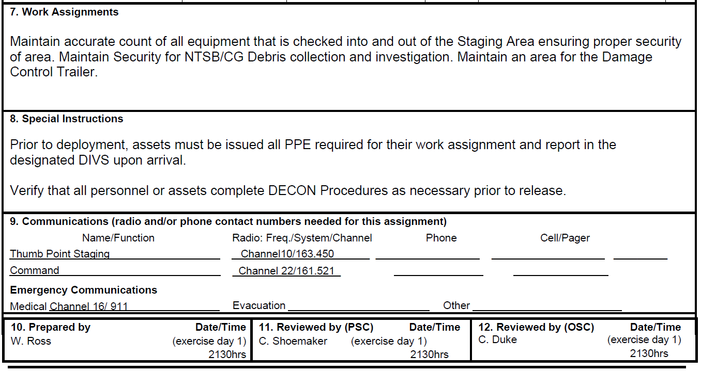
ICS 204 Work Assignments
Box 7: Work Assignments
Completed by OSC – this should match the tactics assigned from the ICS-234 and ICS-215
Box 8: Special Instructions
Information provided by SOFR and PSC
Missing: Location of Site Safety Plan
Notes:
Work Assignment: statement of the tactical objectives to be achieved within the operational period by personnel assigned to divisions or groups.
Note – it does not say how to use supplies or equipment. Supplies and equipment are resources available for the personnel to complete the tactical objectives, and should ALWSY be used in accordance with manufacturer guidance, industry best practice, and workplace safety regulations.
Special Instructions: notification of any safety problems, specific precautions, or other important information

Slide 25
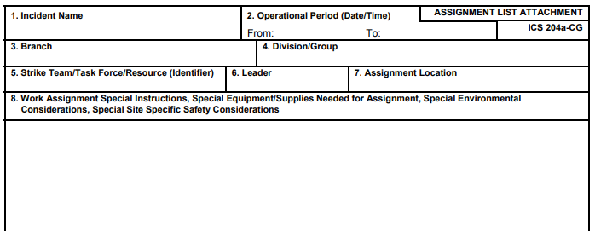
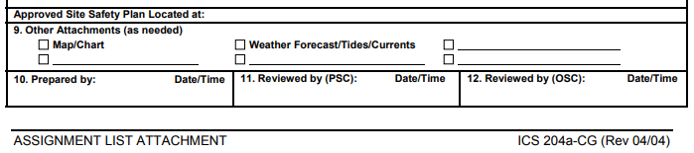
ICS 204a Work Assignment Attachment
Notes:
Specific instructions for specific resources may be entered on an ICS 204a-CG for dissemination to the field. The Assignment List Attachment, ICS 204a-CG shows more specific assignment information, if needed.
The need for an ICS 204a-CG is determined by the Planning and Operations Section Chiefs during the Operational Planning Worksheet (ICS 215-CG) development.

Slide 26
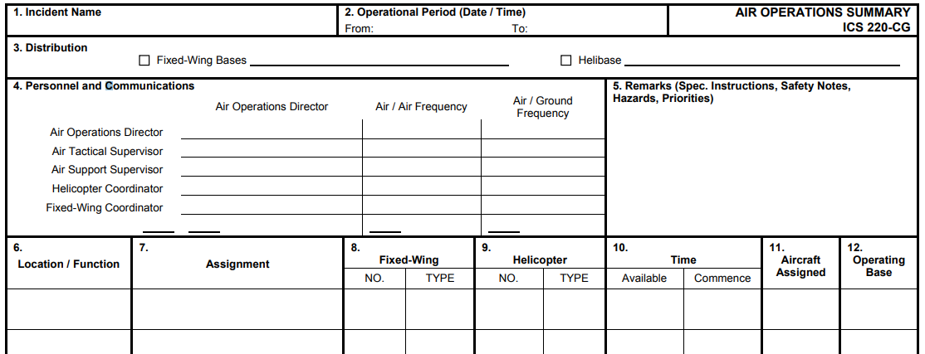
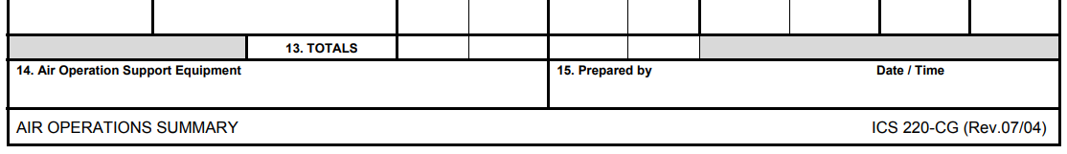
ICS 220 Air Ops Summary
Equivalent of ICS-204 Work Assignment for aviation assets
Notes:
AIR OPERATIONS SUMMARY (ICS 220-CG)
Purpose. The Air Operations Summary provides the Air Operations Branch with the number, type, location, and specific assignments of aircraft.
Preparation. The Operations Section Chief or the Air Operations Branch Director completes the summary during each Planning Meeting. General air resource assignment information is obtained from the Operational Planning Worksheet (ICS 215-CG). The Air and Fixed-Wing Support Groups provide specific designators of the air resources assigned to the incident.
Distribution. After the summary is completed by Air Operations personnel (except item 11), the form is given to the Air Support Group Supervisor, who completes the form by indicating the designators of the helicopters and fixed-wing aircraft assigned missions during the specified operational period. This information is provided to Air Operations personnel who, in turn, give the information to the Resources Unit. All completed original forms MUST be given to the Documentation Unit.

Slide 27



Round table
Questions?
Discussion
Thank you for your participation

Slide 28
Additional Sessions
COMMAND STAFF
Planning section
LOGISTICS SECTION
Finance/ADMIN & INTEL sections
PAC-3IM Reserve IMAT | Planning Team

