Slide 1
ICS Forms and Functions
Seminar Series
Planning Section
March 13, 2021 PAC-3IM Reserve IMAT

Slide 2

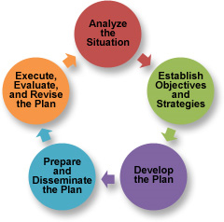
Overview
This course is designed to bridge the gaps between ICS 300, ICS 400, and position specific training – providing an overall awareness the responsibilities, tools, and nuances of each major position/role within the Incident Command System.
This training series is designed to be used as a supplement to NIMS All-Hazard training, position qualification task books, job aids, and the Incident Management Handbook as we progress from seminar to tabletop (TTX) to full-scale (FSE) exercises.
Notes:
From a training and execution standpoint, it is just as important to know what the person beside you is expected to do as the details of what you are supposed to do. This allows for efficiencies of the system to be realized with members performing their piece in a focused manner, trusting that what is not their direct responsibility is still getting done.

Slide 3
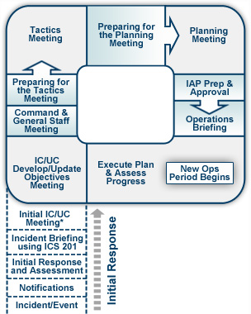
Overview
ICS is both an organizational structure and a process; follow the ICS structure flexibly but follow the ICS process rigidly.
Common Terminology
Integrated Communications
Modular Organization
Unified Command Structure
Manageable Span of Control
Consolidated Action Plans
Comprehensive Resource Management
Agency Inter-Operability
Notes:
It is imperative that incident commanders and all assigned personnel have the knowledge of the system and proficiency with their roles as assigned by position. This enables members to perform as a team and trust in the process.
The organizational structure is meant to adapt to the needs of the incident.
The process, however, is what makes the system effective between agencies because of its “common language” and formalized process, especially the planning process, which is proven to be highly effective in an interagency effort.
The ICS process does not eliminate the requirement to make difficult decisions but provides a structure and process to make well informed decisions. About 80% of a response structure, including overarching decisions and objectives is common between response types. The remaining 20% of each IAP will be incident specific requiring more focused IC/UC collaboration.

Slide 4
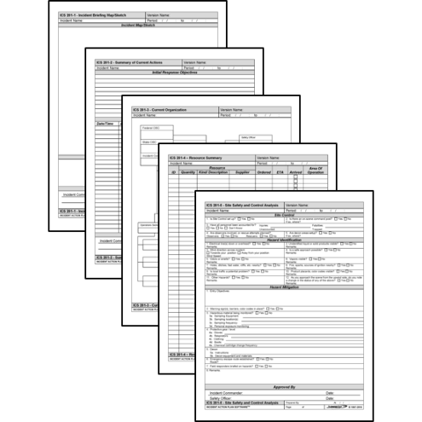
Introduction to Forms
The ICS forms are valuable tools that can be used to:
Gather and disseminate information
Develop a common operational picture and situational awareness
Provide a comprehensive understanding of incident status, intended objectives, and resource utilization
Assist in building the IAP in conjunction with and supporting the planning process
Account for all participants operating at the incident
Ensure there is a legal and historical record of the event
Notes:
ICS forms are valuable tools to assist in developing a simple plan that can be communicated through briefings.
Using ICS forms to gather information provides a template for strategic, operational, and tactical planning

Slide 5
Forms: Coast Guard / FEMA
ICS Form: | Form Title: | Typically Prepared By:
ICS 201 | Incident Briefing | Initial Incident Commander
ICS 202 | Incident Objectives | Planning Section Chief
ICS 202A | Command Direction | Planning Section Chief
ICS 202B | Critical Information Requirements | Planning Section Chief
ICS 203 | Organization Assignment List | Resource Unit Leader and Operations Section Chief
ICS 204 | Assignment List | Resource Unit Leader / Operations
ICS 204A | Assignment List Attachment | Resource Unit Leader / Operations
ICS 205 | Incident Radio Communications Plan | Communications Unit Leader
ICS 205A | Communications List | Communications Unit Leader
ICS 206 | Medical Plan | Medical Unit Leader / Safety Officer
ICS 207 | Incident Organizational Chart | Resource Unit Leader
ICS 208 | Site Safety Plan | Safety Officer
ICS 209 | Incident Status Summary | Situation Unit Leader
ICS 210 | Resource Status Change | Comms/ Resource Unit Leader
ICS 211 | Incident Check-In List | Resource Unit Leader
ICS Form: | Form Title: | Typically Prepared By:
ICS 211A | Sign-in Worksheet | Resource Status / Check-In Recorder
ICS 213 | General Message | Any Message Originator
ICS 213RR | Resource Request | Any Resource Requestor
ICS 214 | Activity Log | All Sections and Units
ICS 214A | Chronology of Events Log
ICS 215 | Operational Planning Worksheet | Operations Section Chief / Resource Unit Leader
ICS 215A | Incident Action Plan Safety Analysis | Safety Officer
ICS 219-1 to 219-10 | Resource Status Cards (T-Cards) | Resource Unit Leader
ICS 220 | Air Operations Summary Worksheet | Operations Section Chief / Air Branch
ICS 221 | Demobilization Check-Out | Demobilization Unit Leader
ICS 225 | Incident Personnel Performance Rating | Supervisor at the Incident
ICS 230 | Meeting Schedule | Planning Section Chief
ICS 233 | Open Action Tracker | Situation Unit / Planning Section
ICS 234 | Work Analysis Matrix | Operations Section
ICS 239 | Incident Complexity Analysis | Incident Commander

Slide 6
Forms: Incident Support / Other
ICS Form: | Form Title: | Typically Prepared By:
ICS 300 to ICS 330 | Area Command Formatted Series | Area Commands
ICS 232 | Resources At Risk Summary | Environmental Unit Leader
ICS 232A | ACP Site Index | Environmental Unit Leader
ICS 235 | Facilities Needs Assessment | Facility Unit Leader
ICS 236 | Tentative Release List | Demobilization / Resource Unit Leaders
ICS 237 | Mishap Reporting Worksheet | Operations / Safety
ICS 238 | Demobilization Tracking Table | Demobilization Unit Leader
ICS 240 | Information Management Plan | Situation Unit Leader / LOFR
ICS 261 | Incident Property Tracking Worksheet | Logistics
ICS Form: | Form Title: | Typically Prepared By:
ICS 216 | Radio Requirements Worksheet | NFES
ICS 217 | Radio Frequency Worksheet | NFES
ICS 218 | Support Vehicle/Equipment Inventory | NFES
ICS 224 | Crew Performance Rating | NFES
ICS 226 | Individual Personnel Rating | NFES
 | Demobilization Plan | Demobilization Unit Leader
 | Facility Plan | Facility Unit Leader
 | Transportation Plan | Facility Unit Leader
 | Food Plan | Food Unit Leader
 | IAP Cover Sheet | Resource Unit Leader
 | Safety Messages | Safety Officer
 | GAR-II | Operations Section Chief / DIVS / Safety Officer
Coast Guard forms will have a “CG” behind the numbers

Slide 7
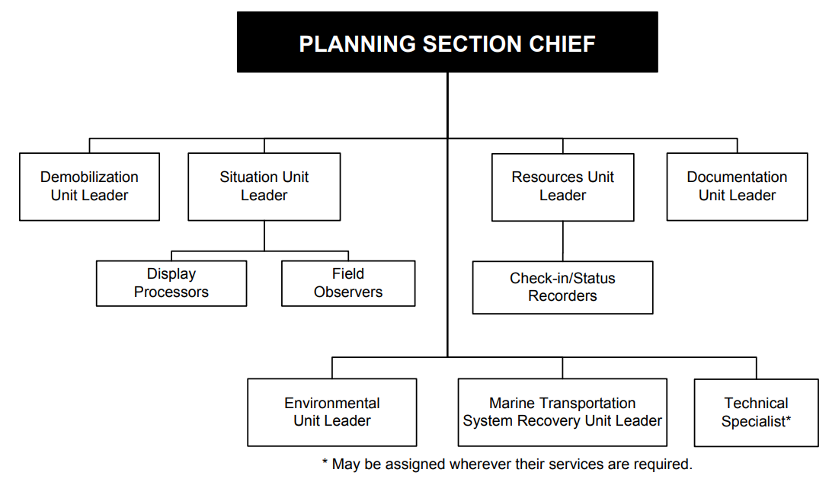
Planning Section
Planning Section is responsible for:
Development of the IAP
Collection, evaluation, dissemination, and use of
incident information
Maintaining status of assigned
and demobilized resources
Provide periodic predictions
on incident potential
Notes:
The Planning Section Chief works closely with all other command and general staff in order to carry out the primary responsibility of information management.
In addition, the PSC will
Facilitate planning meetings and briefings.
Assist OSC in the development of response strategies.
Assign personnel already on-site to ICS organizational positions as appropriate.
Oversee information management processes and plans, including the development and approval of the Information Management Plan
Ensure the accuracy of all information being produced by Planning Section Units with special attention to IC/UC CIRs and their reporting requirements.
Support information requirements and reporting schedules for Planning Section Units (e.g., Resources Unit and Situation Unit).
Establish special information collection activities as necessary (e.g., weather, environmental, and toxics).
Assemble information on alternative strategies.
Keep IMT apprised of any significant changes in incident status.
In addition to the unit leaders listed, the planning section could activate the following specialists:
Lessons Learned Collection Manager (LLCM)
Documentation Technical Specialist.
Environmental Technical Specialist.
Geographic Information System Technical Specialist.
Historian.
Salvage and Engineering Technical Specialist.
Situation Report Technical Specialist.
Training Technical Specialist.
Weather Observer.
Volunteer Technical Specialist/Coordinator.
Remote Sensing Coordinator.
CG Investigative Service Technical Specialist.
Legal specialist.
Senior Enlisted Technical Specialist.
Senior CG Auxiliary Technical Specialist. (Recommended when 15 or more CG Auxiliary members/units are activated to support the incident).
Chaplain.
Sexual Assault Response Coordinator.
Scientific Support Coordinator.
Source Control Support Coordinator.
NIMS/National Response Framework (NRF) Technical Specialist.

Slide 8
Planning Section – ICS-233 Open Action Tracker
Available in PDF or Excel
Excel format has two tabs, one for open and one for closed action items
Notes:
The Planning Section Chief is the primary owner of the ICS 202 Incident Objectives, ICS 202A Command Direction, and 202B Critical Information Requirements, which we covered in the Command Staff Seminar.
The only other form under the immediate direction of the PSC is the Open Action Tracker, which is usually delegated to a DOCL or SITL for maintenance.
Open Actions Tracker (ICS 233-CG - revision 07-12)
Purpose. Open Actions Tracker
Is used by the Incident Commander/Unified Command (IC/UC) to assign and track tasks/actions to IMT personnel that do not rise to the level of being an Incident Objective.
Is duplicated and provided to Command and General Staff members, giving them the open tasks/actions needing to be completed and a means to track the open tasks/actions they have been assigned.
Note: This form may also be used by Command and General Staff for tracking tasks/actions within a Section/Staff element.
Preparation. The Planning Section Chief (PSC) is responsible for maintaining the Open Actions Tracker for the IC/UC and typically utilizes the Documentation Unit Leader (DOCL) to assist in this forms development and updating. The PSC should ensure all Command and General Staff are prepared to discuss their assigned tasks/actions during the Command and General Staff and Planning Meetings.
Distribution. When completed, the form is duplicated, and copies are distributed to the Unified Command and Command and General Staff. It is also posted on a status board located at the ICP. All completed original forms MUST be given to the Documentation Unit.

Slide 9

Planning Section - RESL
Resource Unit Leader (RESL)
Responsible for maintaining the status of all assigned tactical resources and personnel at an incident
Notes:
The Resource Unit Leader is tasked with maintaining a master roster of all tactical resources and personnel checked in at the incident and.
Activation of a Check-In/Status Recorder can help with the requirements to:
Establish the check-in function at incident locations. (ICS 211-CG)
Prepare the Organization Assignment List (ICS 203-CG) and Incident Organization Chart (ICS 207-CG)
Prepare appropriate parts of the Assignment List (ICS 204-CG)
Maintain current status and location using the Resource Status Card (ICS 219) (T-Cards) or an electronic resource tracking system

Slide 10
Planning Section – IAP Prep
1. Incident Name | 2. Operational Period to be covered by IAP (Date/Time) From: To: | CG IAP COVER SHEET
3. Approved by Incident Commander(s): ORG NAME
INCIDENT ACTION PLAN The items checked below are included in this Incident Action Plan: ICS 202-CG (Incident Objectives) ICS 202A-CG (Command Direction) ICS 203-CG (Organization List) – OR – ICS 207-CG (Organization Chart) ICS 204-CGs (Assignment Lists) One Copy each of any ICS 204-CG attachments: ICS 205-CG (Communications Plan) ICS 206-CG (Medical Plan) ICS 208-CG (Site Safety Plan) or Note SSP Location Map / Chart Weather Forecast / Tides/Currents Other Attachments
4. Prepared by: Date/Time NAME, DUTY POSITION DD MMM YY / TIME
PSC/Command
PSC/Command
RESL
RESL/OSC
COML
MEDL or SOFR
SOFR
SITL or DPRO
ENVL/Wx Obs/SITL
Notes:
While the Resource Unit Leader is responsible for the assembly of the IAP, most forms will come from other members within the incident.
We will cover the RESL portion of the ICS-204 under the Operations Seminar

Slide 11
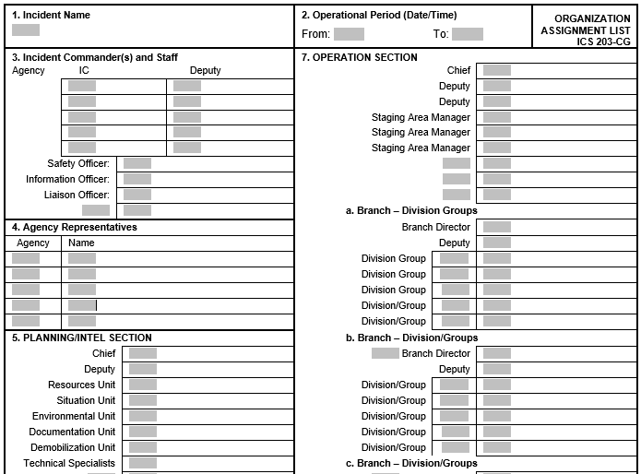
ICS-203 Organization Assignment List
Typically, only one form for organizational structure is required (either ICS-203 or ICS-207)
ICS-203 is easier to use if shifts are switching frequently or extensive positions or technical specialists are activated as it scales beyond one page
Notes:
ORGANIZATION ASSIGNMENT LIST (ICS 203-CG) Instructions for filling out the form
Purpose. The Organization Assignment List provides ICS personnel with information on the units that are currently activated and the names of personnel staffing each position/unit. It is used to complete the Incident Organization Chart (ICS form 207-CG) which is posted on the Incident Command Post display. An actual organization will be event-specific. Not all positions need to be filled. The size of the organization is dependent on the magnitude of the incident and can be expanded or contracted as necessary.
Preparation. The Resources Unit prepares and maintains this list under the direction of the Planning Section Chief.
Note: Depending on the incident, the Intelligence and Information function may be organized in several ways: 1) within the Command Staff as the Intelligence Officer; 2) As an Intelligence Unit in Planning Section; 3) As an Intelligence Branch or Group in the Operations Section; 4) as a separate General Staff Intelligence Section; and 5) as an Intelligence Technical Specialist. The incident will drive the need for the Intelligence and Information function and where it is located in the ICS organization structure. The Intelligence and information function is described in significant detail in NIMS and in the Coast Guard Incident Management Handbook (IMH).
Distribution. The Organization Assignment List is duplicated and attached to the Incident Objectives form (ICS 202-CG) and given to all recipients of the Incident Action Plan. All completed original forms MUST be given to the Documentation Unit.

Slide 12
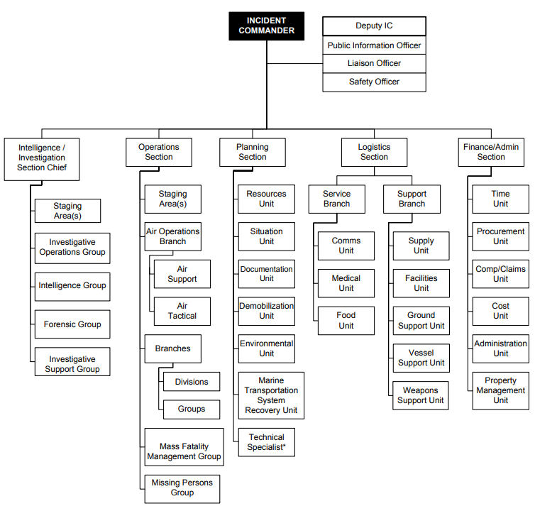
ICS-207 Incident Organization Chart
Traditional Organization Chart layout
Good for static incidents where clearly visible chain of command is useful
Also beneficial for visually representing span of control
Notes:
INCIDENT ORGANIZATION (ICS 207-CG) Revision 1/07
Purpose. The Incident Organization Chart provides ICS personnel with information on the units that are currently activated and the names of personnel staffing each position/unit. An actual organization will be event-specific. Not all positions need to be filled. The size of the organization is dependent on the magnitude of the incident and can be expanded or contracted as necessary.
Preparation. The Resources Unit prepares and maintains this chart under the direction of the Planning Section Chief. The ICS-203 is used to help complete the Incident Organization Chart.
Note: Depending on the incident, the Intelligence and Information function may be organized in several ways: 1) within the Command Staff as the Intelligence Officer; 2) As an Intelligence Unit in Planning Section; 3) As an Intelligence Branch or Group in the Operations Section; 4) as a separate General Staff Intelligence Section; and 5) as an Intelligence Technical Specialist.
The incident will drive the need for the Intelligence and Information function and where it is located in the ICS organization structure. The Intelligence and information function is described in significant detail in NIMS and in the Coast Guard Incident Management Handbook (IMH).
Distribution. The Incident Organization Chart is posted on the Incident Command Post display and may be posted in other places as needed (e.g

Slide 13
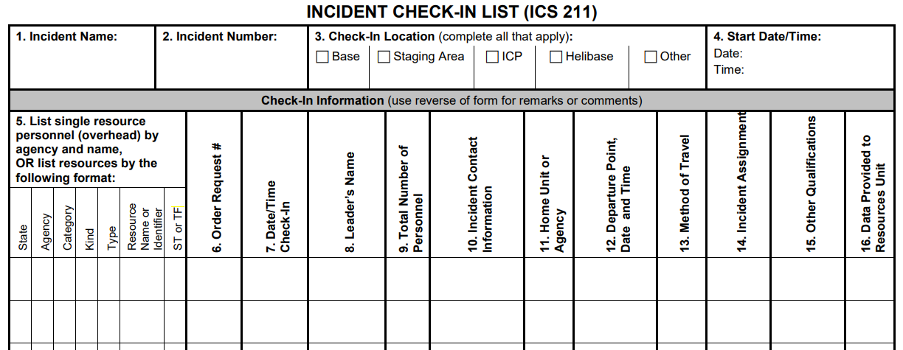
ICS-211 Incident Check In List
Resource Typing Tool: https://rtlt.preptoolkit.fema.gov/public
Notes:
Incident Check-In List
Purpose. Personnel and equipment arriving at the incident can check in at various incident locations. Check-in consists of reporting specific information, which is recorded on the Check-In List (ICS 211).
The ICS 211 serves several purposes, as it:
records arrival times at the incident of all overhead personnel and equipment,
records the initial location of personnel and equipment to facilitate subsequent assignments, and
supports demobilization by recording the home base, method of travel, etc., for resources checked in. Preparation.
The ICS 211 is initiated at a number of incident locations including: Staging Areas, Base, and Incident Command Post (ICP).
Preparation may be completed by:
overhead at these locations, who record the information and give it to the Resources Unit as soon as possible,
the Incident Communications Center Manager located in the Communications Center, who records the information and gives it to the Resources Unit as soon as possible,
a recorder from the Resources Unit during check-in to the ICP.
As an option, the ICS 211 can be printed on colored paper to match the designated Resource Status Card (ICS 219) colors. The purpose of this is to aid the process of completing a large volume of ICS 219s.

Slide 14
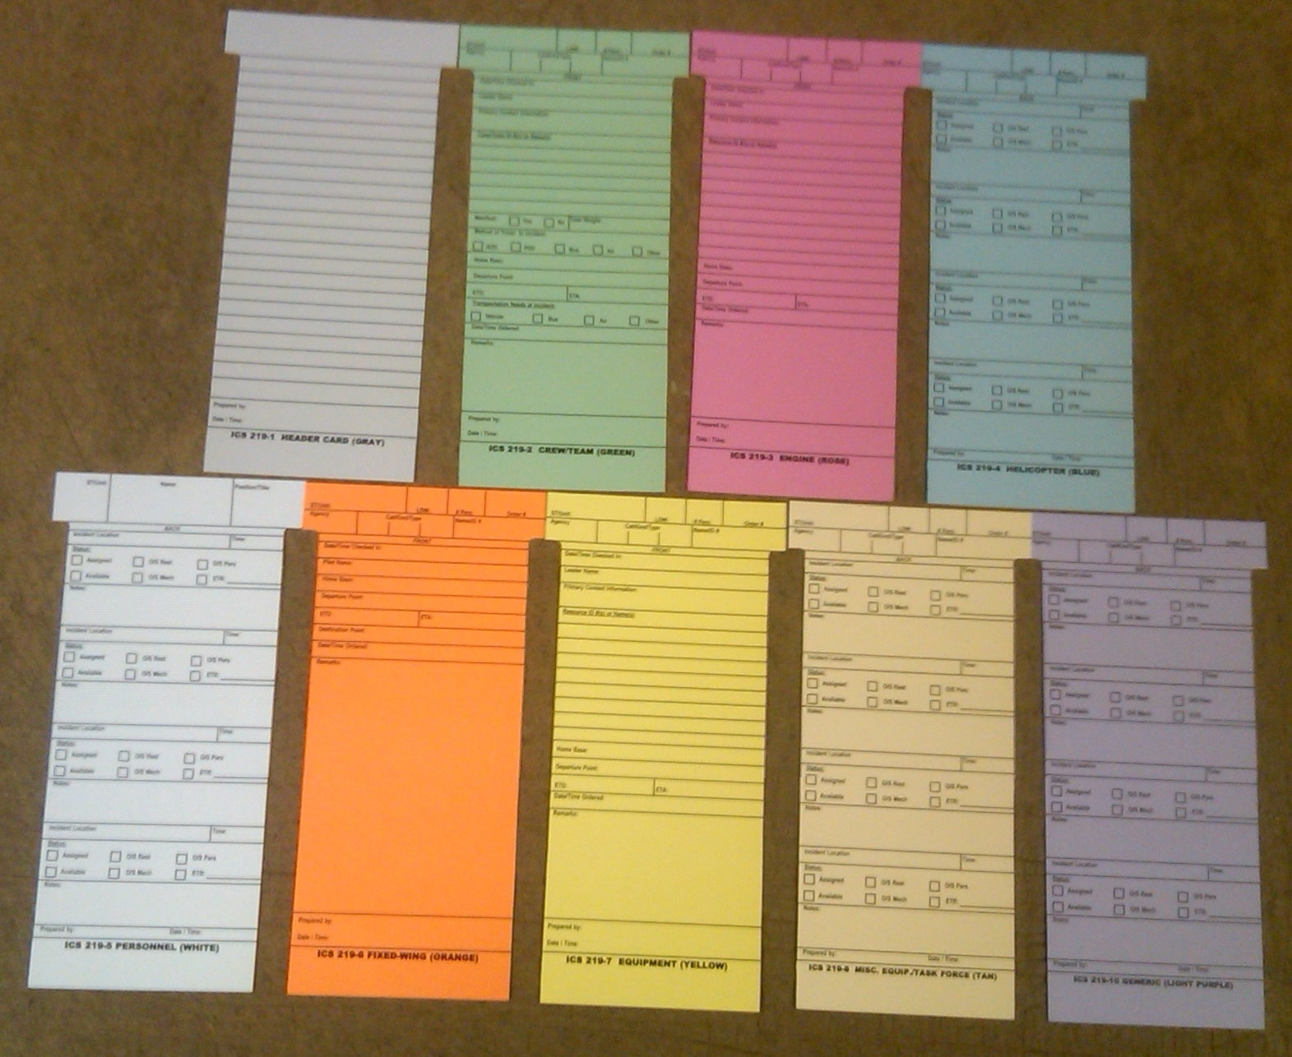
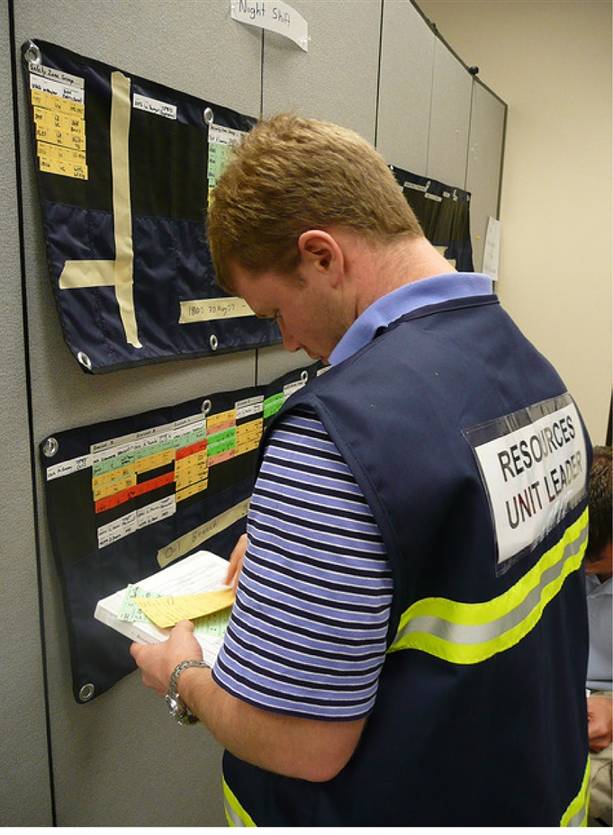

Planning Section – ICS-219 Resource Status Cards
If the incident doesn’t have access to a traditional T-Card system, get creative with your visual display!
Colored Post-it notes
Online Resource Trackers (look like sports team
draft boards)
Excel Sheet
Notes:
ICS 219 Resource Status Card (T-Card)
Purpose. Resource Status Cards (ICS 219) are also known as “T-Cards,” and are used by the Resources Unit to record status and location information on resources, transportation, and support vehicles and personnel.
These cards provide a visual display of the status and location of resources assigned to the incident.
Preparation. Information to be placed on the cards may be obtained from several sources including, but not limited to: • Incident Briefing (ICS 201). • Incident Check-In List (ICS 211). • General Message (ICS 213). • Agency-supplied information or electronic resource management systems.
Distribution. ICS 219s are displayed in resource status or “T-Card” racks where they can be easily viewed, retrieved, updated, and rearranged. The Resources Unit typically maintains cards for resources assigned to an incident until demobilization. At demobilization, all cards should be turned in to the Documentation Unit.
Notes. There are eight different status cards (see list below) and a header card, to be printed front-to-back on cardstock. Each card is printed on a different color of cardstock and used for a different resource category/kind/type.
The format and content of information on each card varies depending upon the intended use of the card.
• 219-1: Header Card – Gray (used only as label cards for T-Card racks)
• 219-2: Crew/Team Card – Green
• 219-3: Engine Card – Rose
• 219-4: Helicopter Card – Blue
• 219-5: Personnel Card – White
• 219-6: Fixed-Wing Card – Orange
• 219-7: Equipment Card – Yellow
• 219-8: Miscellaneous Equipment/Task Force Card – Tan
• 219-10: Generic Card – Light Purple
Acronyms. Abbreviations utilized on the cards are listed below:
• AOV: Agency-owned vehicle
• ETA: Estimated time of arrival
• ETD: Estimated time of departure
• ETR: Estimated time of return
• O/S Mech: Out-of-service for mechanical reasons
• O/S Pers: Out-of-service for personnel reasons
• O/S Rest: Out-of-service for rest/recuperation purposes/guidelines, or due to operating time limits/policies for pilots, operators, drivers, equipment, or aircraft
• POV: Privately owned vehicle

Slide 15
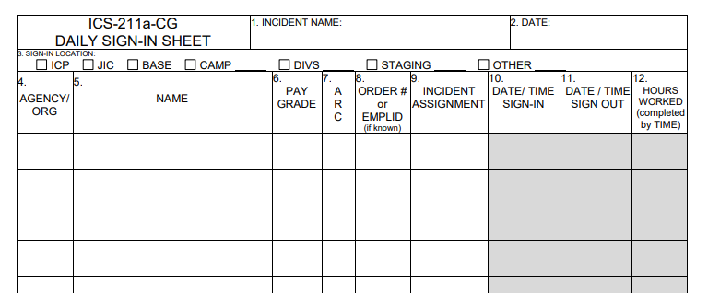
ICS-211A Sign-In Worksheet
An optional form to use as a daily sign-in sheet to track personnel hours worked
New form completed daily (up to 24 hours)
Personnel who have not checked in on the incident must first check-in on the ICS-211 Check-In List
Notes:
DAILY SIGN-IN SHEET (ICS 211a-CG)
Purpose. This is an optional form to use as a daily sign-in sheet to track personnel hours worked on the incident for personnel already checked-in at the incident.
Personnel who have not checked in on the incident must first check-in on the ICS-211 Check-In List.
Preparation.
The Daily Sign-In Sheet is initiated daily (up to 24-hour period) at a number of incident locations including ICP, JIC, base, camps, helibase and in the field.
Leaders and Managers at these locations record the personnel sign-in information.
The same form is used when personnel sign-out. When all personnel are signed out for the day, the completed form is turned in to the Resources Unit.
This form is not used for tactical equipment which are noted on the ICS-204 Assignment List because these resource hours are tracked by the operations section personnel on an ICS-214 Unit Log.
Distribution.
Daily Sign-In Sheets are provided to both the Resources Unit and the Finance Section (Time Unit) to track time of incident personnel.
The Resources Unit maintains a master list of all equipment and personnel that have reported to the incident and uses the Daily Sign-In Sheet to track hours for these personnel.
Time Unit tracks the hours personnel have worked for pay purposes.
All completed original forms MUST be given to the Documentation Unit.

Slide 16
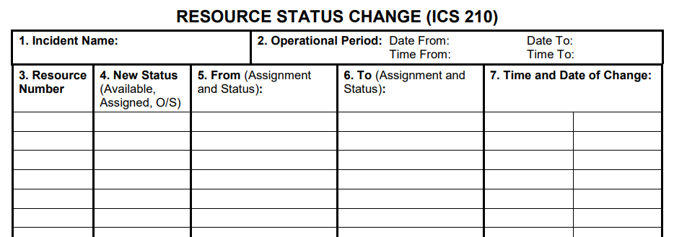
ICS-210 Resource Status Change
Could also be used by Operations to track entry
The ICS 210 is essentially a message form that can be used to update Resource Status Cards or T-Cards (ICS 219) for incident-level resource management
Notes:
ICS 210 Resource Status Change
Purpose. The Resource Status Change (ICS 210) is used by the Incident Communications Center Manager to record status change information received on resources assigned to the incident.
This information could be transmitted with a General Message (ICS 213).
Preparation. The ICS 210 is completed by radio/telephone operators who receive status change information from individual resources, Task Forces, Strike Teams, and Division/Group Supervisors.
Status information could also be reported by Staging Area and Helibase Managers and fixed-wing facilities.
Distribution. The ICS 210 is maintained by the Communications Unit and copied to Resources Unit and filed by Documentation Unit.
Notes: • The ICS 210 is essentially a message form that can be used to update Resource Status Cards or T-Cards (ICS 219) for incident-level resource management.

Slide 17
Planning Section - SITL
Situation Unit Leader (SITL)
Responsible for collecting, processing, organizing and disseminating incident information relating to status of current operations, incident growth, mitigation, or intelligence activities taking place on the incident.
Notes:
The Situation Unit Leader is tasked with maintaining a current and open communication about the current status of the incident.
Prepare the Incident Status Summary (ICS 209-CG).
Conduct situation briefings at meetings and briefings as required by the PSC.
Develop the Information Management Plan, as required, in coordination with PIO, LOFR, OSC, PSC, INTL, LSC, and COML for IC/UC approval.
The use of Display Processor(s) (DPRO) and/or Field Observers (FOBS) help in the acquisition and dissemination of incident information.
Prepare, post, and disseminate resource and situation status information as required, including special requests.
Collect, process, organize and disseminate incident information relating to status of current operations, incident growth, mitigation, or intelligence activities taking place on the incident.
Prepare future projections of incident growth, maps, intelligence, and other incident specific predictions as requested by the PSC.
Coordinate with COML to develop capabilities and capacities to support the information management methodologies.
Provide charts, maps, and overlay imagery.
Develop required displays in accordance with time limits for completion.
Examples of displays include: 1. GIS information. 2. Demographic information. 3. Incident projection data. 4. Enlargement of ICS forms.
Analyze and evaluate field reports related to: 1. Perimeters of the incident. 2. Locations of trouble spots. 3. Weather conditions. 4. Hazards. 5. Progress of operations. 6. Status of resources.

Slide 18
Planning Section – ICS 230 Meeting Schedule
1. Incident Name |  | 2. Operational Period (Date/Time) From: To: |  |  | DAILY MEETING SCHEDULE ICS 230-CG
3. Meeting Schedule (Commonly-held meetings are included)
Date/ Time | Meeting Name |  | Purpose | Attendees |  | Location
 | Unified Command Objectives Meeting |  | Review/ identify objectives for the next operational period. | Unified Command members
 | Command & General Staff Meeting |  | IC/UC gives direction to Command & General staff including incident objectives and priorities | IC/UC, Command & General Staff
 | Tactics Meeting |  | Develop/Review primary and alternate Strategies to meet Incident Objectives for the next Operational Period. | PSC, OSC, LSC, RESL & SITL
 | Planning Meeting | Review status and finalize strategies and assignments to meet Incident Objectives for the next Operational Period. | Determined by the IC/UC
 | Operations Briefing | Present IAP and assignments to the Supervisors / Leaders for the next Operational Period. | IC/UC, Command & General Staff, Branch Directors, Div/Gru Sups., Task Force/Strike Team Leaders and Unit Leaders
4. Prepared by: (Situation Unit Leader) Date/Time
DAILY MEETING SCHEDULE ICS 230-CG (Rev.07/04)
Notes:
DAILY MEETING SCHEDULE (ICS 230-CG)
Purpose. The Daily Meeting Schedule records information about the daily scheduled meeting activities.
Preparation. This form is prepared by the Situation Unit Leader and coordinated through the Unified Command for each operational period or as needed. Commonly-held meetings are already included in the form. Additional meetings, as needed, can be entered onto the form in the spaces provided. Time and location for each meeting must be entered. If any of these standard meetings are not scheduled, they should be crossed out on the form.
Distribution. After coordination with the Unified Command, the Situation Unit Leader will duplicate the schedule and post a copy at the Situation Status Board and distribute to the Command Staff, Section Chiefs, and appropriate Unit Leaders. All completed original forms MUST be given to the Documentation Unit.

Slide 19
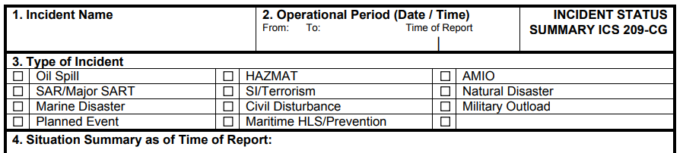
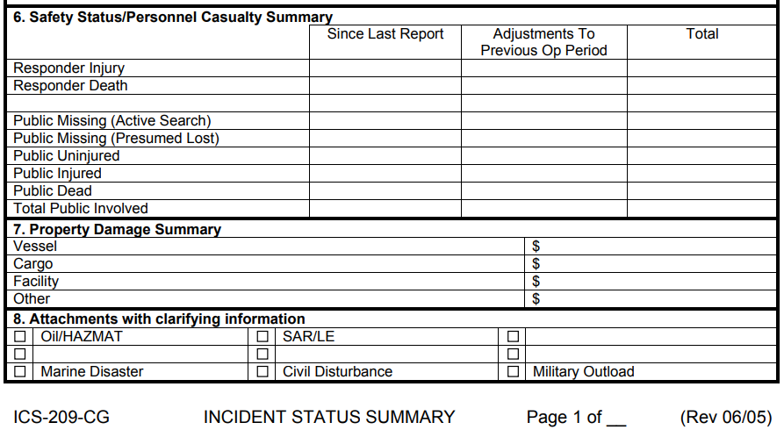
ICS-209 Incident Status Summary
Coast Guard typically uses an incident-specific modified version of this form for rolling up unit reports and creating a consolidated report up to District/Area Commands at regular intervals.
Notes:
INCIDENT STATUS SUMMARY (ICS FORM 209-CG)
Purpose. The Status Summary:
Is used by Situation Unit personnel for posting information on Status Boards or attaching as a file to the MISLE Case.
Is duplicated and provided to Command Staff members, giving them basic information for planning for the next operational period.
Provides information to the Information Officer for preparing news media releases.
Summarizes incident information for local and off-site coordination/operations centers.
Coast Guard typically uses an incident-specific modified version of this form for rolling up unit reports and creating a consolidated report up to District/Area Commands at regular intervals.
Preparation. The Situation Unit prepares the Status Summary.
Resources information should be obtained from the Resources Unit. It may be scheduled for presentation to the Planning Section Chief and other General Staff members prior to each Planning Meeting and may be required at more frequent intervals by the Unified Command or Planning Section Chief. Suggested sources of information are noted in brackets.
Note: The values on the ICS form 209-CG are the best available estimates at the Time of Report (Item # 2 on form).
A suggested source within the ICS organization is noted in brackets [ ] at the top right of each section of the form. All fields need not be completed in order to distribute the form.
Distribution. When completed, the form is duplicated and copies are distributed to the Unified Command and staff, and all Section Chiefs, Planning Section Unit Leaders, and the Joint Information Center.
It is also posted on a status board located at the ICP. All completed original forms MUST be given to the Documentation Unit.

Slide 20
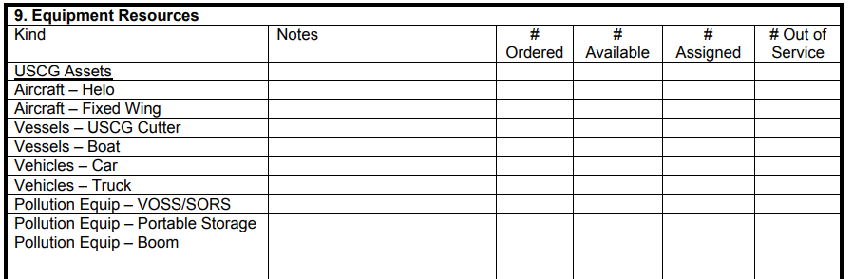
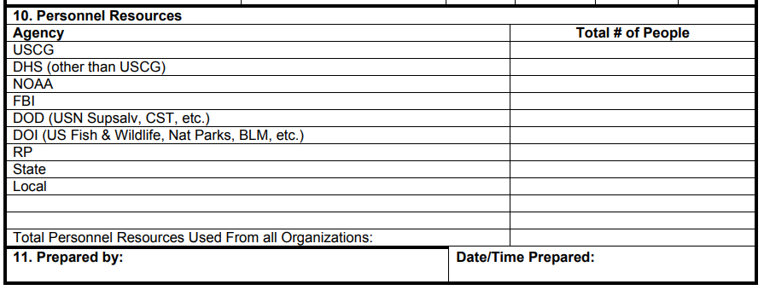
ICS-209 Incident Status Summary
This form is usually in high demand and should be filled out early and often.
Notes:
INCIDENT STATUS SUMMARY (ICS FORM 209-CG)
Purpose. The Status Summary:
Is used by Situation Unit personnel for posting information on Status Boards or attaching as a file to the MISLE Case.
Is duplicated and provided to Command Staff members, giving them basic information for planning for the next operational period.
Provides information to the Information Officer for preparing news media releases.
Summarizes incident information for local and off-site coordination/operations centers.
Coast Guard typically uses an incident-specific modified version of this form for rolling up unit reports and creating a consolidated report up to District/Area Commands at regular intervals.
Preparation. The Situation Unit prepares the Status Summary.
Resources information should be obtained from the Resources Unit. It may be scheduled for presentation to the Planning Section Chief and other General Staff members prior to each Planning Meeting and may be required at more frequent intervals by the Unified Command or Planning Section Chief. Suggested sources of information are noted in brackets.
Note: The values on the ICS form 209-CG are the best available estimates at the Time of Report (Item # 2 on form).
A suggested source within the ICS organization is noted in brackets [ ] at the top right of each section of the form. All fields need not be completed in order to distribute the form.
Distribution. When completed, the form is duplicated and copies are distributed to the Unified Command and staff, and all Section Chiefs, Planning Section Unit Leaders, and the Joint Information Center.
It is also posted on a status board located at the ICP. All completed original forms MUST be given to the Documentation Unit.

Slide 21
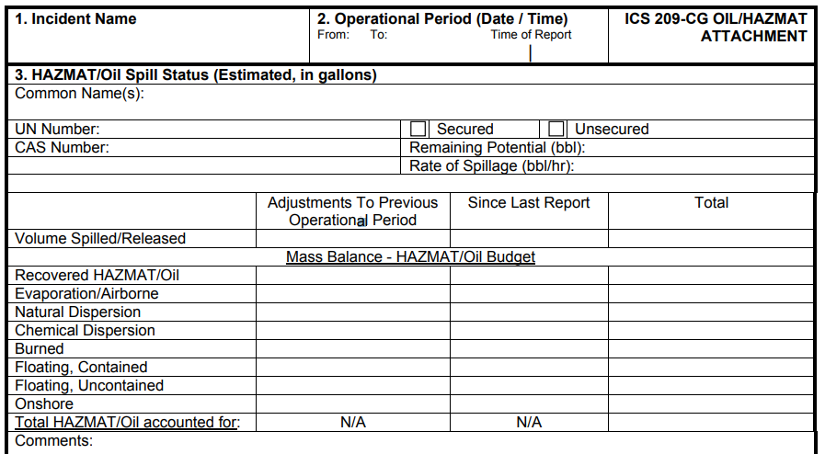
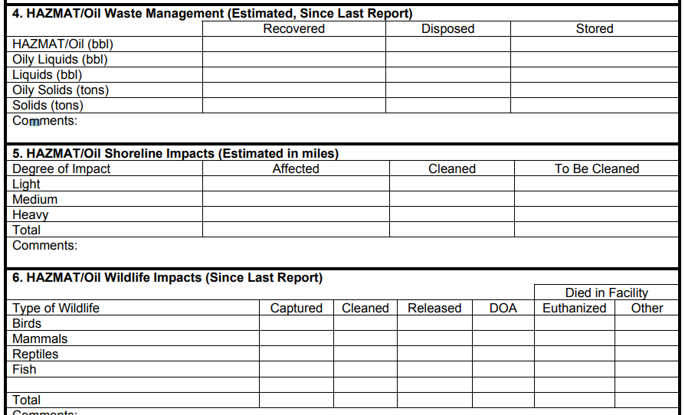
ICS-209 Oil/HazMat Attachment
Notes:
INCIDENT STATUS SUMMARY (ICS FORM 209-CG)
Purpose. The Status Summary:
Is used by Situation Unit personnel for posting information on Status Boards or attaching as a file to the MISLE Case.
Is duplicated and provided to Command Staff members, giving them basic information for planning for the next operational period.
Provides information to the Information Officer for preparing news media releases.
Summarizes incident information for local and off-site coordination/operations centers.
Coast Guard typically uses an incident-specific modified version of this form for rolling up unit reports and creating a consolidated report up to District/Area Commands at regular intervals.
Preparation. The Situation Unit prepares the Status Summary.
Resources information should be obtained from the Resources Unit. It may be scheduled for presentation to the Planning Section Chief and other General Staff members prior to each Planning Meeting and may be required at more frequent intervals by the Unified Command or Planning Section Chief. Suggested sources of information are noted in brackets.
Note: The values on the ICS form 209-CG are the best available estimates at the Time of Report (Item # 2 on form).
A suggested source within the ICS organization is noted in brackets [ ] at the top right of each section of the form. All fields need not be completed in order to distribute the form.
Distribution. When completed, the form is duplicated and copies are distributed to the Unified Command and staff, and all Section Chiefs, Planning Section Unit Leaders, and the Joint Information Center.
It is also posted on a status board located at the ICP. All completed original forms MUST be given to the Documentation Unit.

Slide 22
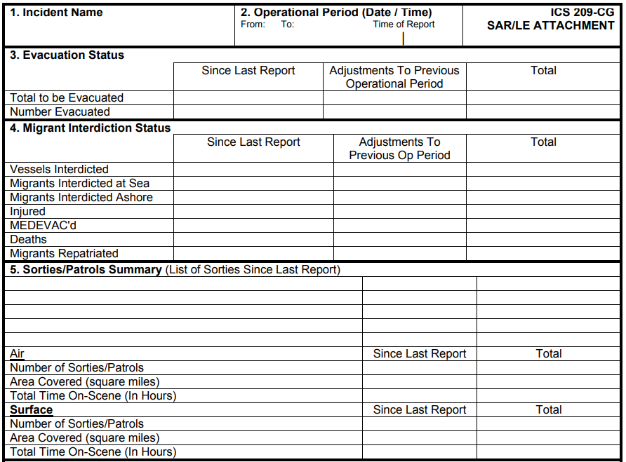
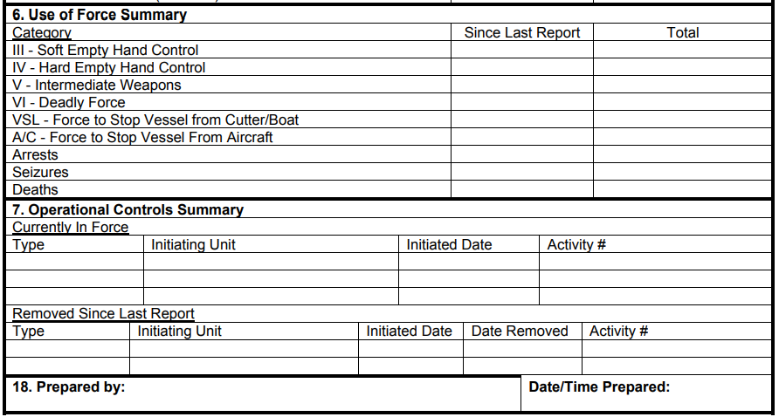
ICS-209 SAR/LE Attachment
Notes:
INCIDENT STATUS SUMMARY (ICS FORM 209-CG)
Purpose. The Status Summary:
Is used by Situation Unit personnel for posting information on Status Boards or attaching as a file to the MISLE Case.
Is duplicated and provided to Command Staff members, giving them basic information for planning for the next operational period.
Provides information to the Information Officer for preparing news media releases.
Summarizes incident information for local and off-site coordination/operations centers.
Coast Guard typically uses an incident-specific modified version of this form for rolling up unit reports and creating a consolidated report up to District/Area Commands at regular intervals.
Preparation. The Situation Unit prepares the Status Summary.
Resources information should be obtained from the Resources Unit. It may be scheduled for presentation to the Planning Section Chief and other General Staff members prior to each Planning Meeting and may be required at more frequent intervals by the Unified Command or Planning Section Chief. Suggested sources of information are noted in brackets.
Note: The values on the ICS form 209-CG are the best available estimates at the Time of Report (Item # 2 on form).
A suggested source within the ICS organization is noted in brackets [ ] at the top right of each section of the form. All fields need not be completed in order to distribute the form.
Distribution. When completed, the form is duplicated and copies are distributed to the Unified Command and staff, and all Section Chiefs, Planning Section Unit Leaders, and the Joint Information Center.
It is also posted on a status board located at the ICP. All completed original forms MUST be given to the Documentation Unit.

Slide 23
Planning Section - DOCL
Documentation Unit Leader (DOCL)
Responsible for the
maintenance of accurate,
up-to-date incident documentation
Maintain files for legal, analytical, and historical purposes
Notes:
Examples of incident documentation include IAP(s), incident reports, communication logs, injury claims, and situation status reports. Some of the documents may originate in other sections. The DOCL should ensure each section is maintaining and providing appropriate documents.
Develop a documentation plan to include archival of all incident specific information data as defined in the Information Management Plan.
Coordinate with the COML to ensure electronically stored information meets legal documentation and archival requirements.
To the greatest extent possible the data archive should be readily recoverable and searchable.
Ensure appropriate level of documentation storage is maintained based on the level of classification of the information being stored.
Maintain the Incident Open Action Tracker (ICS 233- CG).
Establish duplication service and respond to duplication requests.
File all official forms and reports.
Develop a Freedom of Information Act (FOIA) plan in coordination the LOFR and with appropriate legal input.

Slide 24
Planning Section - DMOB
Demobilization Unit Leader (DMOB)
Coordinates with AREPS
for the release of other
agency resources
Monitors ongoing operations
section needs,
Identifies surplus resources
and probable release times
Notes:
The DMOB is responsible for developing the Incident Demobilization Plan. On large incidents, demobilization can be very complex, requiring a separate planning activity.
Develop an Incident Demobilization Plan that should include:
General information section.
Responsibilities section.
Release priorities.
Release procedures (including unique procedures needed for Reserve members).
Demobilization Checkout Form (ICS 221-CG).
Prepare appropriate directories (e.g., maps and instructions) for inclusion in the demobilization plan.
Track all demobilized tactical resources and overhead personnel to their home unit.
Distribute demobilization plan (on and off-site).
Provide status reports to appropriate requestors.

Slide 25
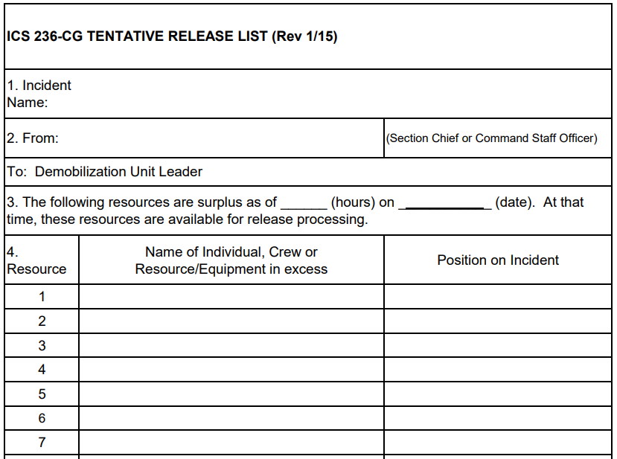
ICS-236 Tentative Release List
An optional form used by Command and General Staff to identify excess or surplus resources on the incident for the Demobilization Unit Leader.
Notes:
TENTATIVE RELEASE LIST (ICS 236-CG)
Purpose. The Tentative Release List is a optional form used by Command and General Staff to identify excess or surplus resources on the incident for the Demobilization Unit Leader.
Preparation. The Tentative Release List is prepared by the Command and General Staff after receiving input from their staff on any surplus resources at least 24 hours in advance of their anticipated demobilization time.
The Resources Unit Leader will work with the Operations Section Chief to identify Operations resources.
The list of identified surplus resources is given to the Section Chief/Command Staff Officer who will sign and forward to the Demobilization unit.
The Demobilization Unit will compile a tentative list of surplus resources from these lists from all Command and General Staff and submit a consolidated release list to the Incident Commander/Unified Command for approval (via the Planning Section Chief).
Distribution. The Tentative Release List is given to the Demobilization Unit Leader. All completed original forms MUST be given to the Documentation Unit.

Slide 26
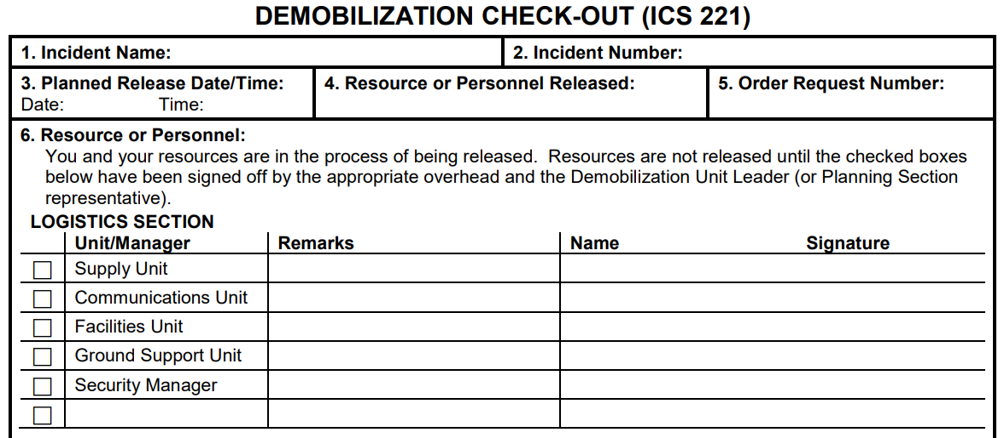
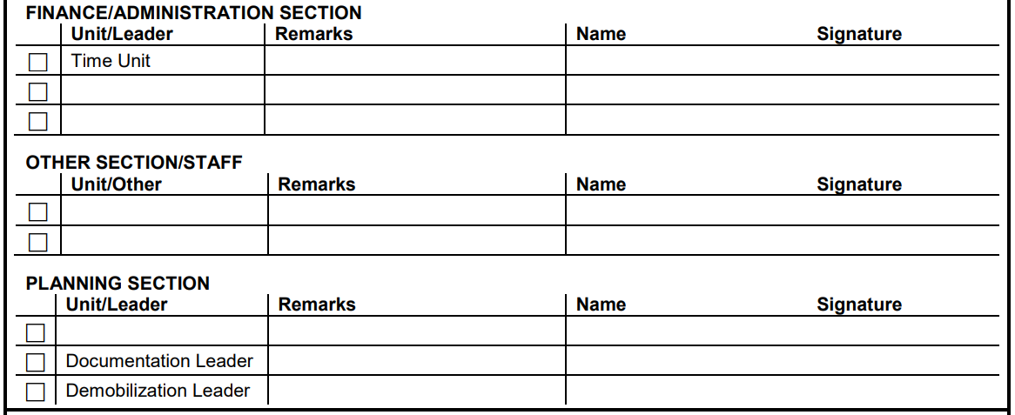
ICS-221 Demobilization Check-Out
Notes:
ICS 221 Demobilization Check-Out
Purpose. The Demobilization Check-Out (ICS 221) ensures that resources checking out of the incident have completed all appropriate incident business, and provides the Planning Section information on resources released from the incident.
Demobilization is a planned process and this form assists with that planning.
Preparation. The ICS 221 is initiated by the Planning Section, or a Demobilization Unit Leader if designated. The Demobilization Unit Leader completes the top portion of the form and checks the appropriate boxes in Block 6 that may need attention after the Resources Unit Leader has given written notification that the resource is no longer needed. The individual resource will have the appropriate overhead personnel sign off on any checked box(es) in Block 6 prior to release from the incident.
Distribution. After completion, the ICS 221 is returned to the Demobilization Unit Leader or the Planning Section. All completed original forms must be given to the Documentation Unit.
Personnel may request to retain a copy of the ICS 221.

Slide 27
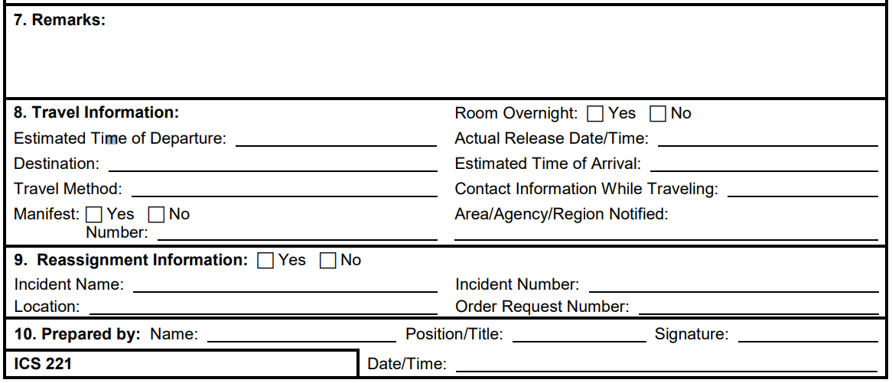
ICS-221 Demobilization Check-Out
Members are not released until form is complete when all of the items checked in Block 6 have been signed off.
Notes:
ICS 221 Demobilization Check-Out
Purpose. The Demobilization Check-Out (ICS 221) ensures that resources checking out of the incident have completed all appropriate incident business, and provides the Planning Section information on resources released from the incident.
Demobilization is a planned process and this form assists with that planning.
Preparation. The ICS 221 is initiated by the Planning Section, or a Demobilization Unit Leader if designated. The Demobilization Unit Leader completes the top portion of the form and checks the appropriate boxes in Block 6 that may need attention after the Resources Unit Leader has given written notification that the resource is no longer needed. The individual resource will have the appropriate overhead personnel sign off on any checked box(es) in Block 6 prior to release from the incident.
Distribution. After completion, the ICS 221 is returned to the Demobilization Unit Leader or the Planning Section. All completed original forms must be given to the Documentation Unit.
Personnel may request to retain a copy of the ICS 221.

Slide 28
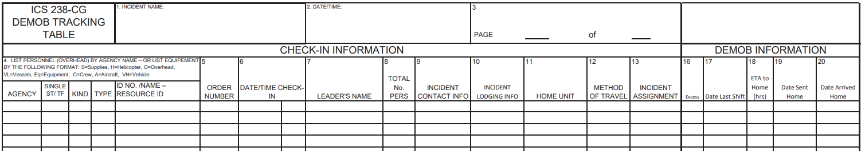
ICS-238 Demobilization Tracking Table
An optional form used the Demobilization Unit Leader to track resources from start to finish of the incident (including demobilization and return to home unit).
Form is in Excel format and designed as an electronic record of assigned personnel
Notes:
DEMOBILIZATION TRACKING TABLE (ICS 238-CG)
Purpose. The Demobilization Tracking Table is an optional form used the Demobilization Unit Leader to track resources from start to finish of the incident (including demobilization and return to home unit).
Preparation. The Demobilization Tracking Table is prepared by the Demobilization Unit Leader to track resources from start to finish of the incident using the information from the ICS-211 Check-In form.
Block’s 1 through 15 are taken directly from the ICS-211’s on the incident and block’s 16-20 are completed when resources are identified for demobilization from the approved release list.
If the ICS211’s were completed in Excel, then the information can be directly copied onto the ICS-238 form in Excel. Any columns not used in the demobilization process can be hidden in Excel (e.g. Block’s 14 and 15).
Also, after a resource has checked in at the home unit and is no longer tracked, that row can be hidden in Excel. The information can be sorted based on a particular column (e.g. Excess block is checked) to help sort and utilize information. In addition, additional columns can be added to track other information if needed (e.g. Reserve last duty day).
Distribution. The Demobilization Tracking Table is prepared by and used by the Demobilization Unit Leader. All completed original forms MUST be given to the Documentation Unit.

Slide 29
Planning Section - ENVL
Environmental Unit Leader (ENVL)
Responsible for:
Strategic assessment
Modeling
Surveillance
Environmental monitoring
Permitting
Notes:
The ENVL is responsible for environmental matters associated with the response.
The ENVL prepares environmental data for the Situation Unit.
The ENVL should be from a public environmental or natural resource management agency to ensure compliance with applicable laws, regulations, and ordinances.
The National Oceanic and Atmospheric Administration (NOAA) Scientific Support Coordinator (SSC) will work closely with the Environmental Unit but does not typically fill the ENVL position.
provide input on wildlife protection strategies (e.g., removing oiled carcasses, pre-emptive capture, hazing, capture, and treatment).
Develop an Environmental Risk Communications enclosure to the Information Management Plan to assess and address stakeholder perceptions and concerns about environmental, safety, health risks, and hazards.
Coordinate with the LOFR, PIO, and SOFR to sample, compile, and assess data for stakeholder coordination plan, social media plan, and risk communications appendix (e.g., sample results, pollutant transport and fate, seafood safety, and dispersant).
Coordinate with the SSC and LOFR to develop an academia coordination plan as needed to address pollutant transport, fate, extent of contamination, and potential hazards to the public. J. Determine the extent, fate, and effects of contamination.
Acquire, distribute, and provide analysis of weather forecasts.
Monitor the environmental consequences of response actions.
Develop Shoreline Cleanup and Assessment Plans.
Identify the need for and prepare any special advisories or orders.
Identify the need for and obtain permits, consultations, and other authorizations, including Endangered Species Act (ESA) provisions.
Technical specialists assigned to the ENVL typically include:
Sampling
response technologies
trajectory analysis
weather forecast
resources at risk
shoreline cleanup assessment
historical/cultural resources
waste disposal

Slide 30
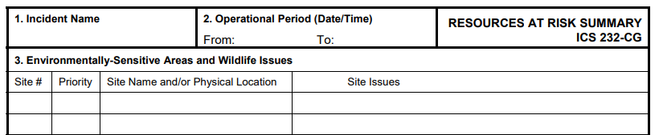
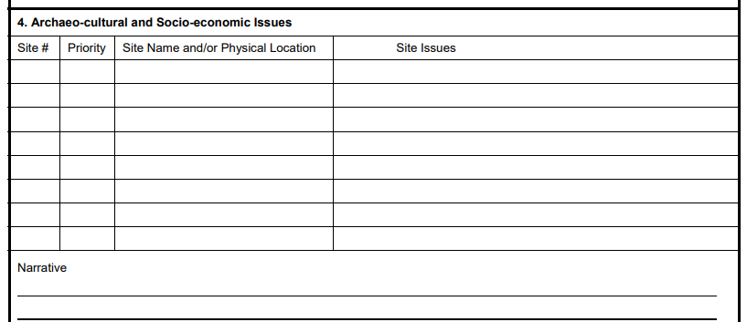
ICS-232 Resources At Risk Summary
Notes:
RESOURCES AT RISK SUMMARY (ICS 232-CG)
Purpose. The Resources at Risk Summary provides information about sites in the incident area which are sensitive due to environmental, archaeo-cultural, or socio-economic resources at risk, and identifies incident-specific priorities and issues.
The information recorded here may be transferred to ICS 232a-CG, which acts as a key to the Area Contingency Plan (ACP) or Geographic Response Plan (GRP) site numbers shown on the Situation Map.
Preparation. The Environmental Unit Leader, with input from resource trustees, will complete this form for each operational period. It should be updated prior to the Planning Meeting.
Distribution. This form must be forwarded to the Planning Section Chief for possible inclusion in the IAP. All completed original forms MUST be given to the Documentation Unit.

Slide 31
Planning Section – MTSL (or MTSRU)
Marine Transportation System Recovery Unit Leader
Responsible for:
planning infrastructure recovery
for transportation security
incidents and other incidents that significantly impact the MTS
Notes:
The MTSL will track and report on the status of the MTS, understand critical recovery pathways, recommend courses of action, and provide all MTS stakeholders with an avenue of input to the response organization.
The MTSL prepares transportation data for the Situation Unit and daily situation briefs applying core Essential Elements of Information (EEIs).
Directly supports Operations Section staff elements that are established for MTS Recovery, coordinating with MTS stakeholders, Maritime Security, LE, oil, hazardous substances, and SAR Groups.
Must be familiar with Area Contingency Plans, Area Maritime Security Plans, MTS Recovery Plans, and associated recovery procedures
Completes the Common Assessment and reporting Tool (CART)
Identify and highlights needs such as ATON, communications systems, dredging, salvage, or cleanup that impact the MTS
Identify the need for and prepare any special advisories or orders (e.g., Safety and Security Zones).
Monitor the capability of the port to operate and support national cargo flow needs. Report performance and cargo flow limitations.
Identify MTS issues and resulting maritime supply chain impacts that could necessitate implementation of relief measures outside the impacted area (e.g., industry redirection of ships or cargo streams).
For incidents impacting more than one CG Sector, provide information to support management of regional issues, including local area impacts that will be felt outside of the immediate response area, such as export delays

Slide 32



Round table
Questions?
Discussion
Thank you for your participation

Slide 33
Additional Sessions
COMMAND STAFF
Operations section
Logistics SECTION
Finance/ADMIN & INTEL sections
PAC-3IM Reserve IMAT | Planning Team

