Slide 1
ICS Forms and Functions
Seminar Series
Command Staff
January 24, 2021 PAC-3IM Reserve IMAT

Slide 2

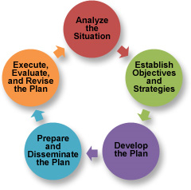
Overview
This course is designed to bridge the gaps between ICS 300, ICS 400, and position specific training – providing an overall awareness the responsibilities, tools, and nuances of each major position/role within the Incident Command System.
This training series is designed to be used as a supplement to NIMS All-Hazard training, position qualification task books, job aids, and the Incident Management Handbook as we progress from seminar to tabletop (TTX) to full-scale (FSE) exercises.
Notes:
From a training and execution standpoint, it is just as important to know what the person beside you is expected to do as the details of what you are supposed to do. This allows for efficiencies of the system to be realized with members performing their piece in a focused manner, trusting that what is not their direct responsibility is still getting done.

Slide 3
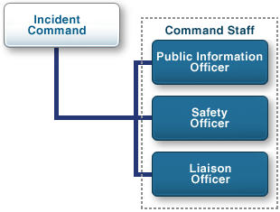
Incident Command and Command Staff
The Command Staff provide Information, Safety, and Liaison services for the entire organization
Notes:
While the Incident Commander sets the objectives has overall responsibility for the incident, they are rarely, if ever, working alone.
Together with:
Public Information Officer: Establishing and delivering strategic messaging, setting the tone for the incident
Safety Officer: Conduct on-scene operations risk management evaluation
Liaison Officer: Establish critical networks, partnerships, and support with outside agencies and organizations, ensuring equitable and resourceful decision making.
Planning Section Chief: Identify and implement priorities and objectives and conduct resource needs assessment
Critical for PIO/SOFR/LOFR to remain focused on the overall requirements of the incident. It is not possible for a single person to do this in a complex incident. The use of APIO/ASOFR/Liaison Network will ensure successful coverage of all assigned tasks leaving the command staff available to the proximity of the IC.

Slide 4
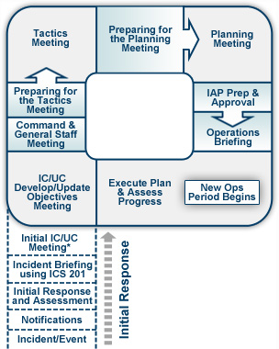
Overview
ICS is both an organizational structure and a process; follow the ICS structure flexibly but follow the ICS process rigidly.
Common Terminology
Integrated Communications
Modular Organization
Unified Command Structure
Manageable Span of Control
Consolidated Action Plans
Comprehensive Resource Management
Agency Inter-Operability
Notes:
It is imperative that incident commanders and all assigned personnel have the knowledge of the system and proficiency with their roles as assigned by position. This enables members to perform as a team and trust in the process.
The organizational structure is meant to adapt to the needs of the incident.
The process, however, is what makes the system effective between agencies because of its “common language” and formalized process, especially the planning process, which is proven to be highly effective in an interagency effort.
The ICS process does not eliminate the requirement to make difficult decisions but provides a structure and process to make well informed decisions. About 80% of a response structure, including overarching decisions and objectives is common between response types. The remaining 20% of each IAP will be incident specific requiring more focused IC/UC collaboration.

Slide 5
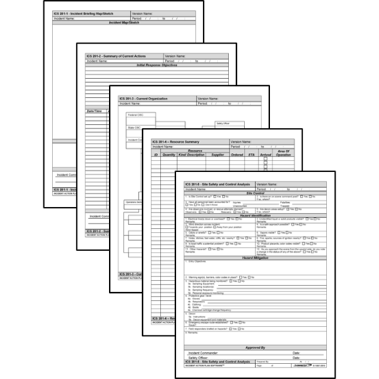
Introduction to Forms
The ICS forms are valuable tools that can be used to:
Gather and disseminate information
Develop a common operational picture and situational awareness
Provide a comprehensive understanding of incident status, intended objectives, and resource utilization
Assist in building the IAP in conjunction with and supporting the planning process
Account for all participants operating at the incident
Ensure there is a legal and historical record of the event
Notes:
ICS forms are valuable tools to assist in developing a simple plan that can be communicated through briefings.
Using ICS forms to gather information provides a template for strategic, operational, and tactical planning

Slide 6
Forms: Coast Guard / FEMA
ICS Form: | Form Title: | Typically Prepared By:
ICS 201 | Incident Briefing | Initial Incident Commander
ICS 202 | Incident Objectives | Planning Section Chief
ICS 202A | Command Direction | Planning Section Chief
ICS 202B | Critical Information Requirements | Planning Section Chief
ICS 203 | Organization Assignment List | Resource Unit Leader and Operations Section Chief
ICS 204 | Assignment List | Resource Unit Leader / Operations
ICS 204A | Assignment List Attachment | Resource Unit Leader / Operations
ICS 205 | Incident Radio Communications Plan | Communications Unit Leader
ICS 205A | Communications List | Communications Unit Leader
ICS 206 | Medical Plan | Medical Unit Leader / Safety Officer
ICS 207 | Incident Organizational Chart | Resource Unit Leader
ICS 208 | Site Safety Plan | Safety Officer
ICS 209 | Incident Status Summary | Situation Unit Leader
ICS 210 | Resource Status Change | Communications Unit Leader
ICS 211 | Incident Check-In List | Resource Unit Leader
ICS Form: | Form Title: | Typically Prepared By:
ICS 211A | Sign-in Worksheet | Resource Status / Check-In Recorder
ICS 213 | General Message | Any Message Originator
ICS 213RR | Resource Request | Any Resource Requestor
ICS 214 | Activity Log | All Sections and Units
ICS 214A | Chronology of Events Log
ICS 215 | Operational Planning Worksheet | Operations Section Chief / Resource Unit Leader
ICS 215A | Incident Action Plan Safety Analysis | Safety Officer
ICS 219-1 to 219-10 | Resource Status Cards (T-Cards) | Resource Unit Leader
ICS 220 | Air Operations Summary Worksheet | Operations Section Chief / Air Branch
ICS 221 | Demobilization Check-Out | Demobilization Unit Leader
ICS 225 | Incident Personnel Performance Rating | Supervisor at the Incident
ICS 230 | Meeting Schedule | Planning Section Chief
ICS 233 | Open Action Tracker | Situation Unit / Planning Section
ICS 234 | Work Analysis Matrix | Operations Section
ICS 239 | Incident Complexity Analysis | Incident Commander

Slide 7
Forms: Incident Support / Other
ICS Form: | Form Title: | Typically Prepared By:
ICS 300 to ICS 330 | Area Command Formatted Series | Area Commands
ICS 232 | Resources At Risk Summary | Environmental Unit Leader
ICS 232A | ACP Site Index | Environmental Unit Leader
ICS 235 | Facilities Needs Assessment | Facility Unit Leader
ICS 236 | Tentative Release List | Demobilization / Resource Unit Leaders
ICS 237 | Mishap Reporting Worksheet | Operations / Safety
ICS 238 | Demobilization Tracking Table | Demobilization Unit Leader
ICS 240 | Information Management Plan | Situation Unit Leader / LOFR
ICS 261 | Incident Property Tracking Worksheet | Logistics
ICS Form: | Form Title: | Typically Prepared By:
ICS 216 | Radio Requirements Worksheet | NFES
ICS 217 | Radio Frequency Worksheet | NFES
ICS 218 | Support Vehicle/Equipment Inventory | NFES
ICS 224 | Crew Performance Rating | NFES
ICS 226 | Individual Personnel Rating | NFES
 | Demobilization Plan | Demobilization Unit Leader
 | Facility Plan | Facility Unit Leader
 | Transportation Plan | Facility Unit Leader
 | Food Plan | Food Unit Leader
 | IAP Cover Sheet | Resource Unit Leader
 | Safety Messages | Safety Officer
 | GAR-II | Operations Section Chief / DIVS / Safety Officer
Coast Guard forms will have a “CG” behind the numbers

Slide 8
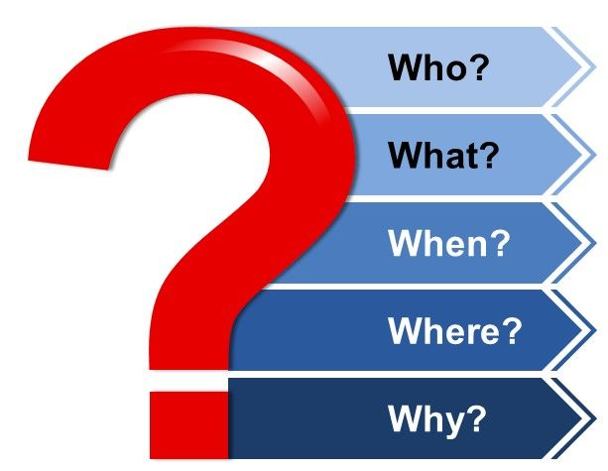
ICS 201: Incident Briefing
Who are key players, stakeholders? Responsible or interested parties?
What is the incident? Where did it take place?
When did the incident take place? How quickly is it changing or evolving?
Where did it take place? What is the nature of the area? Sensitive or environmental, political, hazardous operating environment considerations?
Incident Organization – what resources are already on-site? Incoming? Needed? What is the battle rhythm?
Incident Organization?
Notes:
*This is the equivalent of an IAP for the first operational cycle, or until an IAP is prepared and published.
Who are key players, stakeholders? Responsible or interested parties? What is the incident? Where did it take place?
What type of incident? Any governing laws or plans? Does CG have authority or obligation to lead response?
When did the incident take place? How quickly is it changing or evolving?
Where did it take place? What is the nature of the area? Sensitive or environmental, political, hazardous operating environment considerations?
Incident Organization – what resources are already on-site? Incoming? Needed? What is the battle rhythm? When is next scheduled meeting? Who is in chain of command?
Purpose. The Incident Briefing form provides the Unified Command (and the Command and General Staffs assuming command of the incident) with basic information regarding the response situation and the resources allocated to the incident
Preparation. This briefing form is prepared under the direction of the initial Incident Commander for presentation to the Unified Command. This form can be used for managing the response during the initial period until the beginning of the first operational period for which an Incident Action Plan (IAP) is prepared.
Distribution. After the initial briefing of the Unified Command and General Staff members, the Incident Briefing form is duplicated and distributed to the entire IMT.

Slide 9
Command and Command Staff Dynamics
Rapport, trust, and clear communication are critical for a successful relationship between IC and Command Staff positions.
Upon reporting, and on regular intervals, Command Staff should check in with the IC on:
Expectations of the IC
Experience and focus of IC
Experience and focus of Command Staff
Method to communicate with IC/UC – how often and how update?
Method to relay High Potential Hazards/Risks/Comms to IC/UC - what are trigger points?
Limitations and Constraints
Delegation of Authority, Decision Making
  (Stop operations, commit resources, deliver press brief, etc)
  Approval thresholds
Notes:
Expectations of the IC: IC’s come with many different levels of expertise and experience. In a multi-hazard, multi-jurisdictional incident it is possible and even probable that the IC(s) does not have expertise in providing proactive outreach services to assisting and cooperating agencies and other stakeholders.
IC/UC Safety Priorities for current and next Operational Period
Authority for SOFR and/or Asst SOFR’s to stop operations
Incident Operating Procedures for the IMT in place
Personal Protective Equipment (PPE) and other safety items needed for this response.
Need for IC/UC approval on ICS 213RRs
Limitations on safety personnel and equipment
Rehab/Decon Areas Available
Method to communicate with IC/UC
Method to relay High Potential Hazards/Risks to IC/UC
Demobilization Priorities and Critical Incident Stress Management (CISM) requirements
Direction on Work vs. Rest hours (ratio)
Ability to go on-scene
Other agency/responder assistance with Safety
Communications: Briefings, Critical Reporting Requirements, Formality of exchange

Slide 10
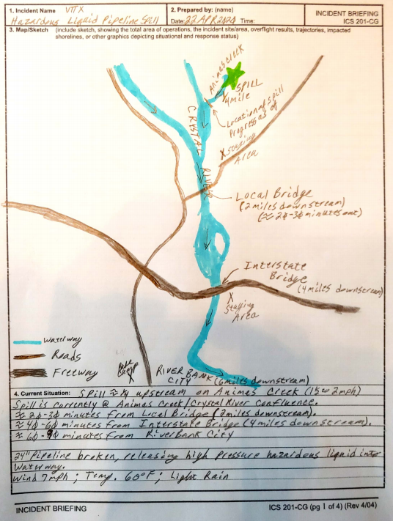
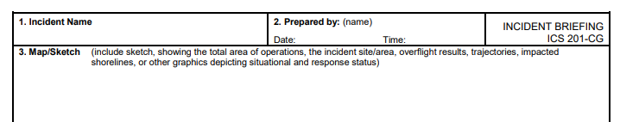
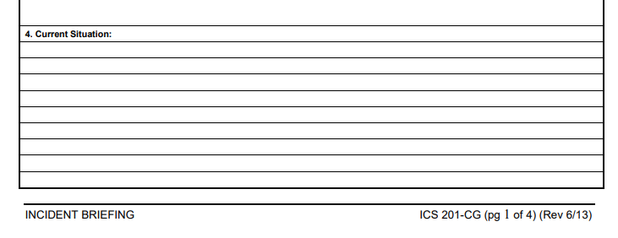
ICS 201: Incident Briefing – page 1
Notes:
*This is the equivalent of an IAP for the first operational cycle, or until an IAP is prepared and published.
ICS 201:
It is a permanent record of the initial incident response. All completed original forms MUST be given to the Documentation Unit.
The information from the ICS form 201-CG can be used as the starting point for other ICS forms or documents. –
Page 1 (Map/Sketch) may transition immediately to the Situation Map. –
The sketch map and summary of current action portions of the briefing form are given to the Situation Unit while the Current Organization and Resources Summary portion are given to the Resources Unit.
This example highlights how informal a 201 can be and still be incredibly effective at capturing and relaying data in order to build situational awareness.

Slide 11
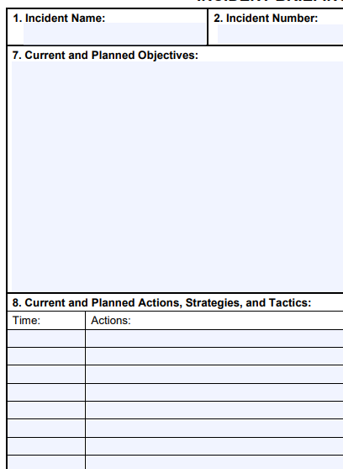
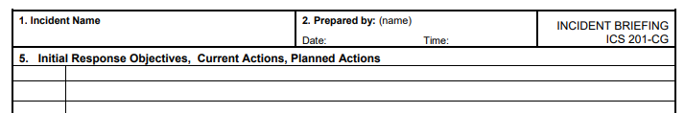
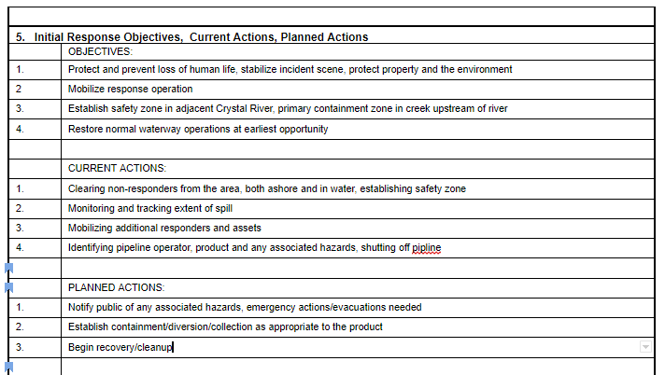
ICS 201: Incident Briefing – page 2
FEMA Form
Coast Guard Form
Notes:
Page 2 (Summary of Current Actions) may be used to continue tracking the response actions and as the initial input to the IAP
This form resembles a radio log, a smooth log, and even an ICS 214 Activity log. This is your notes section with prompts for reporting on objectives, actions, and planning.

Slide 12
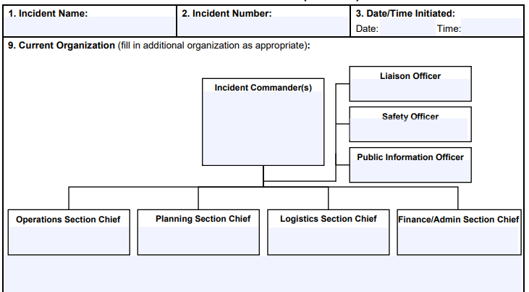
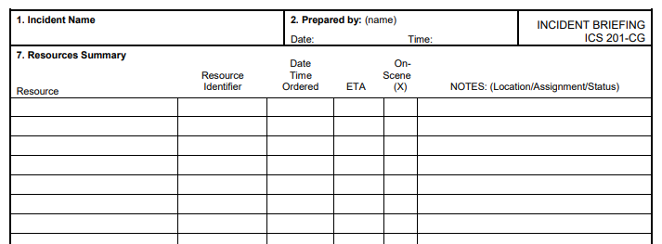
ICS 201: Incident Briefing – pages 3 & 4
What do these pages look like?
Page 3
Page 4
Notes:
Page 3 (Current Organization) may transition immediately to the Organization List (ICS form 203-CG) and/or Organization Chart (ICS form 207-CG). –
Page 4 (Resources Summary) may be used to continue tracking resources assigned to the incident and as input to individual T-Cards (ICS form 219) or other resource tracking system.

Slide 13
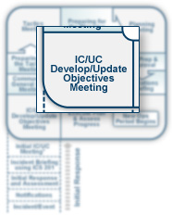
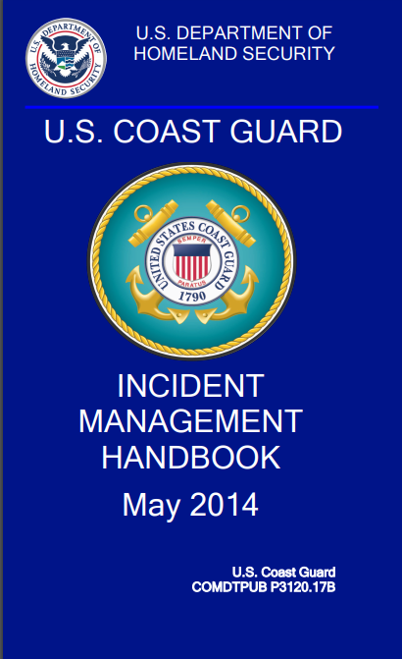
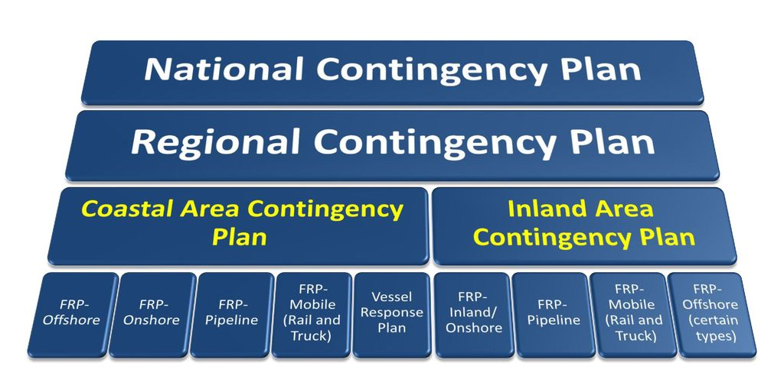
ICS 202: Incident Objectives
Where do Incident Objectives come from?
Pre-Scripted Mission Assignments (PSMAs)
Area Contingency Plans (oil and hazmat)
Incident Management Handbook
Learned Experience / Past Exercises or Events
Notes:
Incident Objectives – describes the basic incident strategies, objectives, command emphasis or priorities, and safety considerations
PSMA - facilitate rapid response and standardized mission assignments. PSMAs are aides to FEMA Federal Coordinating Officers, Coast Guard Joint Field Office (JFO) Support Teams and other representatives for quickly identifying mission support. Each mission assignment shall be considered by the requested agency on an incident specific basis. Agencies can either accept or reject the request based on the current and expected operational demands.
Coast Guard has PSMAs for ESF 9 (Search and Rescue) and ESF 10 (pollution response)

Slide 14
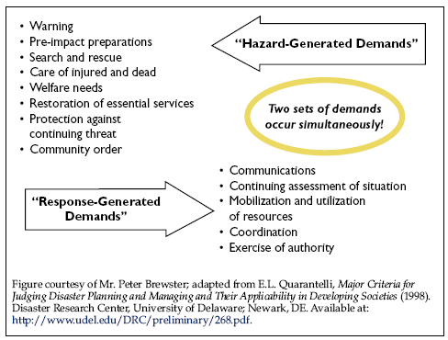
ICS 202: Incident Objectives
Management Objectives v Operational Objectives
Operational Objectives
What do we need to do to respond to and close out the incident?
Management Objectives
How do we manage the incident?
Notes:
Incident Objectives – describes the basic incident strategies, objectives, command emphasis or priorities, and safety considerations
PSMA - facilitate rapid response and standardized mission assignments. PSMAs are aides to FEMA Federal Coordinating Officers, Coast Guard Joint Field Office (JFO) Support Teams and other representatives for quickly identifying mission support. Each mission assignment shall be considered by the requested agency on an incident specific basis. Agencies can either accept or reject the request based on the current and expected operational demands.
Coast Guard has PSMAs for ESF 9 (Search and Rescue) and ESF 10 (pollution response)

Slide 15
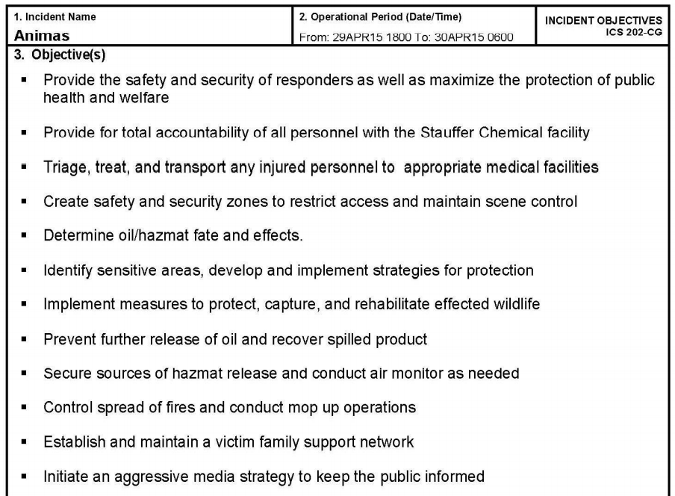
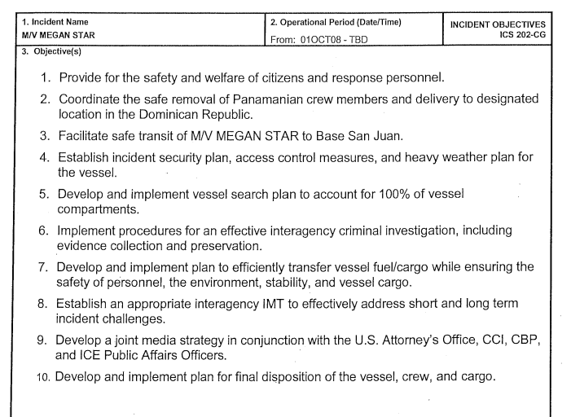
ICS 202: Incident Objectives
Tip: a SMART objective is one that is Specific, Measurable, Attainable, Realistic, and Time Sensitive/Time Bound.
Notes:
Purpose: The Incident Objectives (ICS‑202) form describes the incident objectives, command emphasis/priorities, and safety considerations for the next operational period.
Preparation: The ICS-202 is completed by the Planning Section following each Command and General Staff meeting conducted to prepare the IAP.
Distribution: The ICS-202 is generally the first page of the IAP and given to all supervisory personnel at the Section, Branch, Division/Group, and Unit levels. All completed forms must be given to the Documentation Unit in the Planning Section.
Discuss Pros and cons of each example
Specificity, SMART, numbering, safety focus
What makes a good objective?

Slide 16
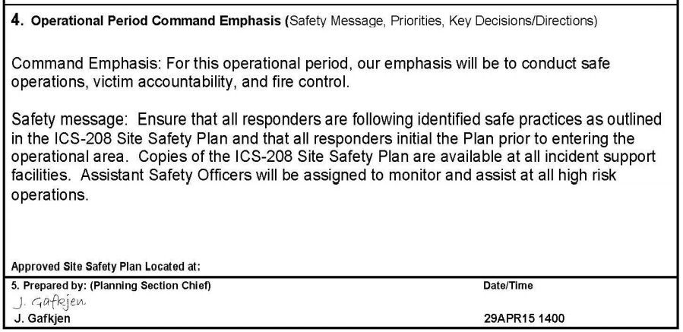
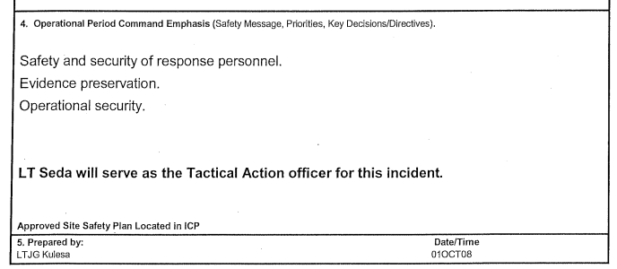
ICS 202: Incident Objectives
Notes:
Block 4 is the area designed to address only the most

Slide 17
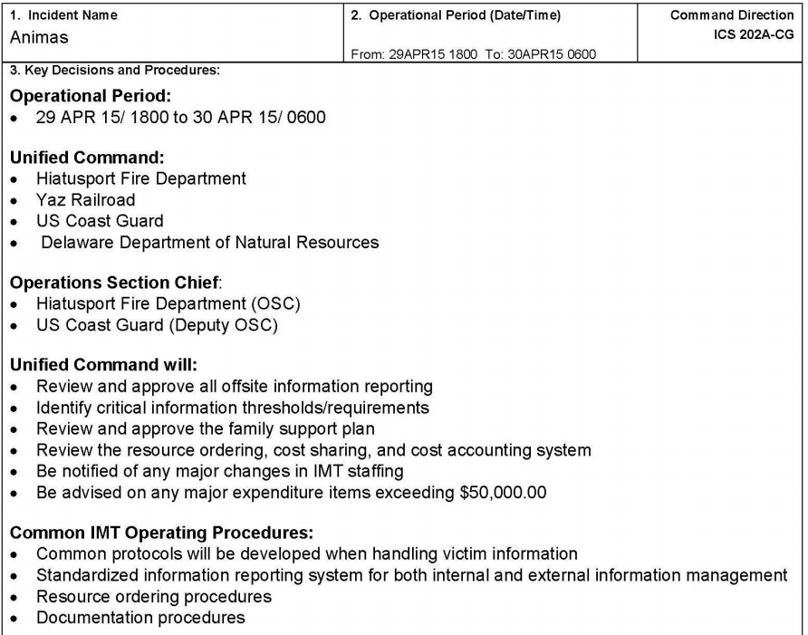
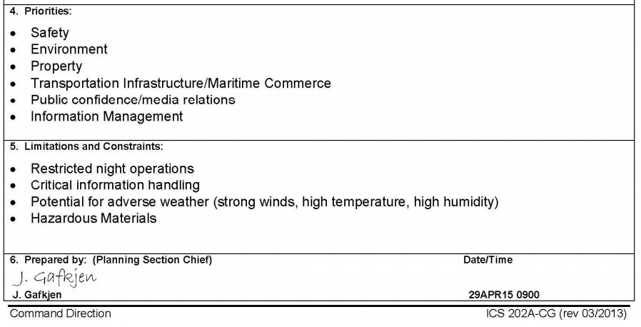
ICS 202A: Command Direction
Notes:
Purpose. The Command Direction form supplements the ICS 202 form by documenting the IC/UC strategic direction and guidance through Key Decisions/Procedures, Priorities and Limitations/Constraints for use during the next operational period.
Preparation. The Command Direction form is completed by the Planning Section following each Unified Command Objectives Meeting conducted (input may be made during the Initial Unified Command Meeting) and aids with Command Direction for the Command and General Staff meeting and when preparing the Incident Action Plan.
Distribution. The Command Direction form may be included with the IAP and given to all supervisory personnel at the Section, Branch, Division/Group, and Unit levels. All completed original forms MUST be given to the Documentation Unit.

Slide 18
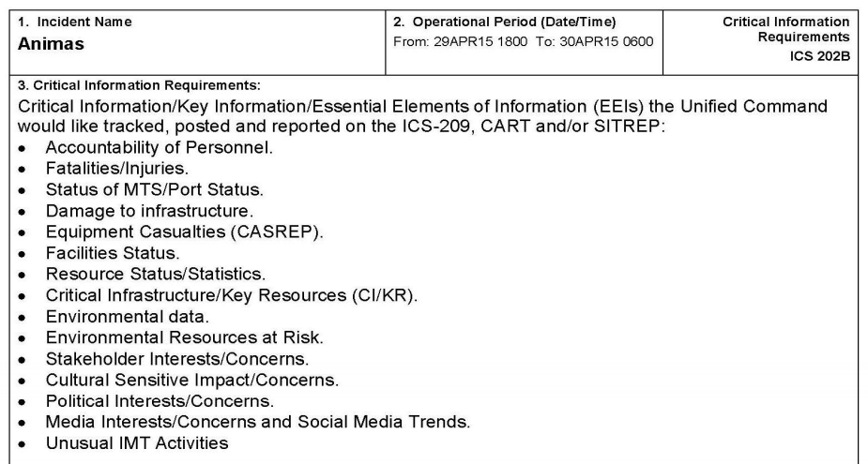
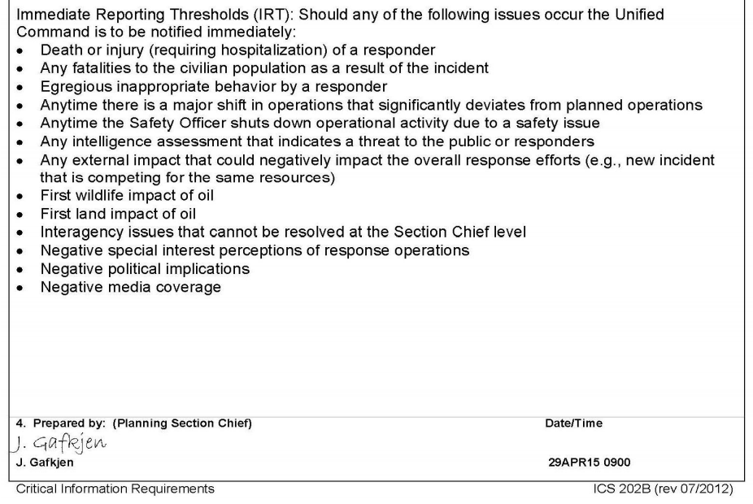
ICS 202B: Critical Information Requirements
Notes:
Purpose. The Critical Information Requirements form supplements the ICS 202 form by documenting the IC/UC strategic direction and guidance through Critical Information Requirements for use during the next operational period.
Preparation. The Critical Information Requirements form is completed and/or updated by the Planning Section following each Unified Command Objectives Meeting (input may be made during the Initial Unified Command Meeting) conducted in preparing the Incident Action Plan.
Distribution. The Critical Information Requirements form may be reproduced with the IAP and should be given to all supervisory personnel at the Section, Branch, Division/Group, and Unit levels. All completed original forms MUST be given to the Documentation Unit.
If the SOFR is not in the UC/IC meeting – they should have a chance to review and comment on any updates or changes.

Slide 19
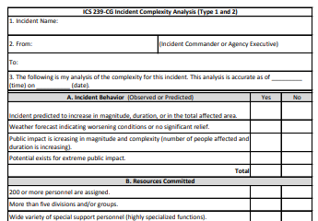
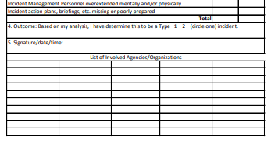
ICS 239: Incident Complexity Analysis
A. through H. listed on following pages
Notes:
The NIMS Guideline for the National Qualification System defines Incident Complexity as the Incident criteria determined by the level of difficulty, severity, or overall resistance faced by incident management or support personnel while trying to manage or support an incident to a successful conclusion or to manage one type of incident or event compared to another type. Incident Complexity is the combination of involved factors that affect the probability of control of an incident.
Many factors determine the complexity of an incident, including, but not limited to, area involved, threat to life and property, political sensitivity, organizational complexity, jurisdictional boundaries, values at risk, weather, strategy and tactics, and agency policy. Incident complexity is considered when making incident management level, staffing, and safety decisions. Incident complexity is assessed on a five-point scale ranging from Type 5 (the least complex incident) to Type 1 (the most complex incident). Various analysis tools have been developed to assist consideration of important factors involved in incident complexity.
Analyze each element and check the response, Yes or No
Total the responses in each section (A through G), these are the primary factors. If total number of "yes" responses is greater than or equal to the number of "no" responses in the section then the section is considered positive.
If any three (3) of the primary factors (A through G) are positive, this indicates the incident situation is or is predicted to be of Type 1 complexity.
Factor H should be considered after elements 1-3 are completed. If more than two of the elements in factor H are answered yes, and three or more of the other primary factors are positive, a Type 1 organization should be considered.
If the composites of H are negative, and there are fewer than three positive responses in the primary factors (A-G), a Type 2 organziation should be considered. If the answers to all questions in H are negative, it may advisable to allow the existing overhead to continue action on the incident.

Slide 20
ICS 239: Incident Complexity Analysis
A. Incident Behavior (Observed or Predicted)
Incident predicted to increase in magnitude, duration, or in the total affected area.
Weather forecast indicating worsening conditions or no significant relief.
Public impact is increasing in magnitude and complexity (number of people affected and duration is increasing.
Potential exists for public impact
B. Resources Committed
200 or more personnel are assigned
Total More than five divisions and/or groups.
Wide variety of special support personnel (highly specialized functions)
Substantial air operation which is not properly staffed.
Majority of available initial responder resources committed.
C. Resources Threatened
Marine Transportation System
Developments and infrastructure facilities – CIKR? NIPP?
Restricted, threatened, or endangered species habitat
Cultural or historical sites
Unique natural resources, special delegation areas, wilderness
Other special resources
D. Safety
Unusually hazardous incident conditions
Serious accidents or fatalities
Threat to public safety from the incident and related operations
Restrictions and/or closures of area surrounding the incident in effect or being considered
No night operations in place for safety reasons

Slide 21
ICS 239: Incident Complexity Analysis
E. Ownership
Incident Involves or threatens more than one jurisdiction
Potential for claims
Different or conflicting management objectives
Disputes over incident responsibility
Potential for Unified Command
F. External Influences
Controversial Emergency Response procedure
Pre-existing controversies/relationships
Sensitive media relationships
Other management problems
Sensitive political areas
Other external influences
G. Change in Strategy
Change in Strategy
Public safety complexes are increasing (disease outbreaks; looting; civil unrest; expanding plume from HazMat; etc.)
Incident Safety Analysis (ISA) invalid or requires updating
H. Existing Incident Management Personnel
Worked two operational periods without achieving initial objectives
Existing management organization ineffective
Incident management personnel overextended mentally or physically
Incident Action Plans (IAP), briefings, etc. missing or poorly prepared.
Notes:
It is critical for the entire command staff to have participation in the evaluation of the incident. There are several safety specific items of obvious interest. The PIO will be interested in anything with a cultural,, political, or community interest, and the LOFR will be engaged in Tribal lands, working with Federal Partners such as DFW and jurisdictions such as local law enforcement.
In many cases – general staff will also be invited to provide feedback and observations
Comments/thoughts on reasons to trigger an Incident Complexity Analysis
What are other options to address/mitigate some of the identified issues?

Slide 22
PIO and LOFR
The responsibilities of the Public Information Officer (PIO) and the Liaison Officer (LOFR) often become intertwined because each position deals with entities outside of the response organization.
BOTH: Serve as primary POC for all stakeholders who are not represented on the Incident Management Team and ensure their concerns, objectives, input, and issues are effectively addressed by someone.
The PIO is responsible to working with the media and general public where the objective is to provide timely information about response efforts to them and ensure that response objectives and public information objectives are aligned to keep news releases and information products accurate.
The LOFR is responsible for working with any public entity requesting incident information, namely assisting and cooperating agencies, stakeholder groups, and government officials who have a vested interest and will be expected to provide input into the response process and will expect situation reports from the Incident/Unified Command.
Notes:
In order to eliminate confusion and overlap, the PIO and LOFR should discuss and decide on the delineation of certain responsibilities.
It is not uncommon for the PIO to attend the Agency Representative Meeting that is held by the LOFR. This is where the LOFR briefs other agencies AREPS to ensure they can support the IAP.

Slide 23
Public Information Officer (PIO)
The primary responsibilities of the Public Information Officer are to effectively coordinate with media and general public interested in the incident. Develop a media strategy, review strategy with Command prior to implementation. Establish contact with other public information personnel. Locate and establish a Joint Information Center (JIC). Provide talking points to Command for press briefings, VIP visits and town hall meetings. Keep command informed of any potential adverse political, social and economic impacts. Serve as key contributor to the public’s perception of the response effort. Manage the public information Staff Organization, including the assignment of Assistant PIOs and forming teams where necessary. Brief Command on public information issues and concerns. Review the Incident Action Plan (IAP) to ensure public information-oriented objectives, messages, issues and information are included as appropriate. Review support and/or contingency plans for integration of stakeholder input and involvement.
Notes:
Strategic Messaging: managing the narrative of the event requires specific attention. Among the most critical means to maintain the confidence of the public and elected officials is through robust, aggressive and targeted strategic messaging. Strategic messaging is not to be confused with routine public affairs outreach. Strategic messaging builds upon strong relationships with key agency leadership, media, and elected officials that must be cultivated by leaders on a regular basis through normal operations. The value of these relationships will facilitate streamlined communication focused on risk communication, safety and environmental issues, public safety and security, etc. during emergencies.
Risk Communication. Detailing public safety, environmental concerns, security threats, and economic impacts through the media following a major event will ease public scrutiny during a response. Such communication is often best delivered by recognized local officials.
PIO needs to be keenly aware of the meeting schedule and when to expect to have updates ready/available for media partners. On complex incidents, the PIO will be scheduling press releases, press briefings, and media availability on the ICS 230 with the Planning Section Chief. Important for the PIO to know POC for facilities in order to adequately support JIC or workspace – food, security, IT, physical access and space layout, etc.
The JIC model is a whole separate course that we will not cover in this series, as an IMAT does not typically assign or support a PIO within the team.

Slide 24
Liaison Officer (LOFR)
Supervise and manage the Liaison Network, providing appropriate information, delegation, authority, and accountability to the Liaison staff.
  ALOFR’s commonly placed at: ICP, EOC’s, JFO
Manage stakeholders, develop and maintain Stakeholder Coordination and Outreach Plans
  Assisting and cooperating agencies
  Agency Representatives
  Interagency contacts
Active participant in meetings – speaking for all stakeholders
Effectively channel assisting agency resources and cooperating agency support into the operational planning process.
ALOFR – double meaning: Important to clarify when working with external stakeholders
Assistant Liaison Officer
Agency Liaison Officers (AKA CG Agency Representative or AREP)
Notes:
When to assign based on experience level, and when to assign based on rank……… technical expertise, jurisdictional authority, other rank-based organizations
The job of liaison during an emergency response is a critical one. It can have a large impact on the efficiency of resource use during the response operations, and on the perception of stakeholders regarding the success or appropriateness of the response activities. Both of these factors are critical to overall response success. Personnel assigned to this position should have a good liaison/governmental affairs background and experience working with people in other organizations. Since this is a key position in the response organization, assignment should be based on experience level versus rank.
Difference between LOFR and AREP:
The LOFR is the Point of Contact for request coming into the ICP from outside agencies. So the Fire Departments want's a fly over of the accident site...they call the Liaison Officer, who coordinates the request up the proper channels.
The Agency Representative is the agency representative at someone else's command post, such as a unified command, a JFO, or FOB. When the unified command IC (or other physical location lead) wants to task Coast Guard assets they tell the CGAREP who then calls the LOFR (or CG POC) to arrange it.
LOFR coordinates incoming taskings from outside agencies...and an AREP is our Representative to other agencies or commands
Common ASSISTANT LOFR positions: Meeting and Briefing Manager, Governmental Affairs Assistant, Documentation and Control Technical Specialists, Administrative, Technical Specialists

Slide 25
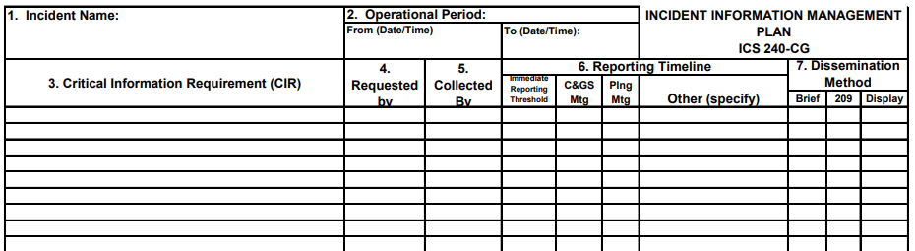
ICS 240: Information Management Plan
Notes:
Purpose. The Information Management Plan is an optional form used the Situation Unit Leader to track Critical Information Requirements (CIRs) during incident.
Often used by both PIO and LOFR to keep record of communications with stakeholders,
identify, track, classify both incoming and outgoing messages.
Preparation. The Information Management Plan is prepared by the Situation Unit Leader (or Deputy Planning Section Chief for Information Management or Deputy Incident Commander for Information Management). If this form is completed in Excel, the information can be sorted based on a particular column (e.g. requested by block) to help sort and utilize information.
Distribution. The Information Management Plan is prepared by and used by the Situation Unit Leader (or Deputy Planning Section Chief for Information Management or Deputy Incident Commander for Information Management) to track status of CIRs. All completed original forms MUST be given to the Documentation Unit.
Other tools include 205a for stakeholders, 203 for supporting and cooperating agencies, etc

Slide 26

Safety Officer (SOFR)
Conduct Safety Evaluation
Develop ICS 208 Site Safety and Health Plan
Brief Personnel on Site Safety and Health Plan
Review ICS 206 Medical Plan
Conduct Operational Risk Analysis
Mitigate Operational Hazards
Mitigate non-Operational Hazards
Attend meetings and provide Safety Status Briefings
Investigate accidents/illnesses
Participate in the development of the Demobilization Plan
Review Communications Plan
Maintain safety documentation
Manage Safety Staff
While the primary customer is Operations,
SOFR will interact a significant
amount with Planning and Logistics
Notes:
Confirm injuries, fatalities, and threats have been identified for both the responders and public.
Confirm identified exclusion, safety, hazard zones; evacuation areas and places of safe refuge.
Review the scene and its specific site hazards.
Develop or begin developing (if not already completed) ICS-208, Site Safety & Health Plan which includes engineering, administrative and personal protective equipment controls for hazards as well as Identifies procedures for emergencies occurring within the incident (injury, accident).
Ensure Safety and Health Plan is briefed to all operation's personnel prior to commencing operations.
ICs come with many different levels of expertise and experience. In a multi-hazard, multi-jurisdictional incident it is possible that the IC/UC does not have expertise in safety activities. Your experience with a specific type of incident gives you insight on safety requirements, methods, and resources necessary to fulfill those expectations. If you don’t have experience with the specific type of incident, it would be to your benefit to request personnel with that experience to serve as an Assistant SOFR.
At a minimum clarify the following expectations from the IC/UC:
Does Command want a safety briefing from you on the process and procedures you typically use as SOFR?
How often does the IC/UC want to be updated?
What are their trigger points?
Define your role - How big a role are you playing? Are you playing the role of more than one position?
Do you have the experience for the role you are playing?
Do you have authority to request additional Safety resources?
Identify special concerns
Determine any limitations and constraints
Discuss guidelines: Determine stop work authority
Demobilization Plan
Provide recommendations to ensure hazards are mitigated
Work/Rest , travel plans, alcohol use, physiological factors (divers), health surveys
Equipment/Vehicle inspection procedures
Responder medical screening programs
Communications Plan
evaluate the Communications Plan to ensure there is adequate communications.
Is the information detailed enough to facilitate good communication?
Do all Divisions and Groups have a tactical frequency assigned?
Is there a frequency assigned to logistical support without tying up tactical or command channels?
Is there a channel for requesting medical aid?
Is there a central command channel?
Are responders training to implement the Communications Plan?
Mitigate Operational Hazards Mitigate safety and occupational health hazards in coordination with the Operations Section.
Deploy Asst SOFRs to the field
Coordinate with other field personnel to obtain other safety information
Work with the OSC to manage work assignment risks and mitigate hazards
Tactical operations are following the IAP (except as modified by the OSC)
OSC/Deputy OSC have good situational awareness
Progress being made to meet operational objectives
Good communications up and down
Personnel are receiving good briefings including safety
Expectations are understood
Operations section personnel are working as a team
Sufficient trained and qualified personnel are available to execute tactical work assignments safely
Proper PPE is being utilized
Hazards being addressed in coordination with the OSC
Span of control is within acceptable limits
Confirm implementation of controls in operations
Ensure Admin Controls are implemented
Ensure available engineering controls are used
Ensure proper Personal Protective Equipment (PPE) is being used
Inform the OSC of any changes
Inform the IC/UC of any significant changes
Attend the Tactics Meeting and Planning Process Meetings and Provide Safety Status Briefs for more info.
Conduct on-going risk assessments and field audits
Develop/Revise ICS 208B Site Safety and Health Plan as needed and communicate revisions to Operations and IMT
Ensure ICS 208B Site Safety and Health Plan is available to all responders
Verify worker acknowledgement of ICS 208B Site Safety and Health Plan
Mitigate Non-Operational Hazards
Mitigate safety, environmental, and occupational health hazards in coordination with the Incident Management Team (IMT).
Conduct on-going risk assessments of nonoperational hazards.
See Facilities Hazard/Risk Identification Checklist
Coordinate with IMT members to obtain safety information
Confirm implementation of controls
Ensure Admin Controls are implemented
Ensure available engineering controls are used
Ensure proper Personal Protective Equipment (PPE) is being used
Inform the IMT members of any changes
Inform the Incident Commander (IC) of any significant changes
Provide information to the Situation Unit
Review other plans to ensure safety hazards are addressed

Slide 27
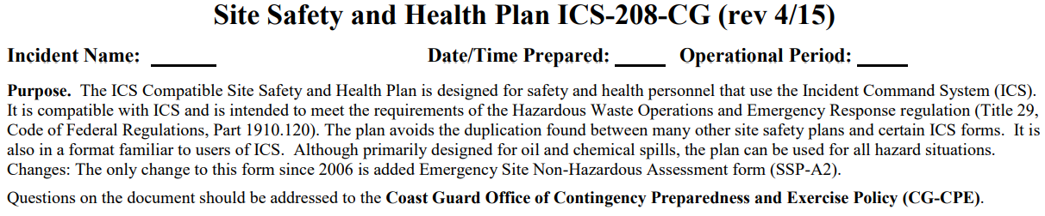
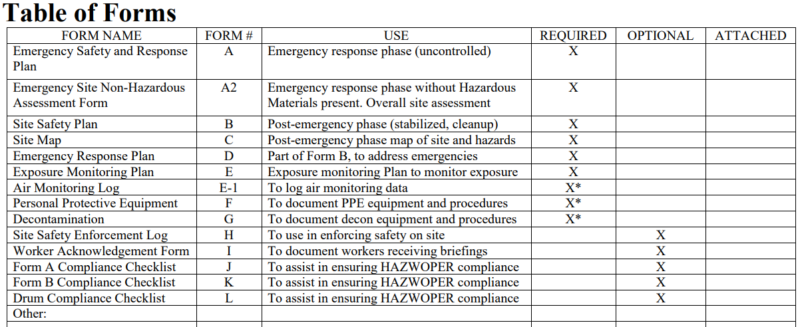
ICS 208: Site Safety Plan
Notes:
FEMA ICS 208 is a SAFETY MESSAGE
CG ICS 208 is SITE SAFETY PLAN
Purpose: The Safety Message/Plan (ICS-208) expands on the Safety Message and Site Safety Plan. It may be included as part of the IAP and is used to convey statements for safety messages, priorities, and key command emphasis/decisions/directions. These messages can include information such as known safety hazards and specific precautions to be observed during an operational period.
Preparation: The ICS-208 is an optional form that may be included and completed by the Safety Officer for the IAP.
Distribution: The ICS-208, if developed, will be reproduced with the IAP and given to all recipients as part of the IAP. All completed forms must be given to the Documentation Unit in the Planning Section
Account for all personnel on scene
Confirm injuries, fatalities & threats to public
Confirm threats to responders
Confirm exclusion, safety, hazard zones; evacuation areas and places of safe refuge
Review the scene and its specific site hazards
Evaluate probability and consequence of hazards
Review the ICS 201
Identify hazards
Identify the incident hazard mitigation strategies
Confirm exclusion zones
Confirm safety zones
Confirm hazards zones
Confirm safe refuge areas
Confirm evacuation areas
Confirm "all safe" communications methods
Review ICS 206 Medical Plan
List controls and practices
List and sketch hazard zones, restricted areas, evacuation zones, places of safe refuge
Identify procedures for emergencies occurring within the incident (injury, accident)
Identify security measures
Identify emergency alarms and hand signals
Identify emergency medical response procedures and contacts
Review OSHA standards and How to Properly Refuse Risk

Slide 28
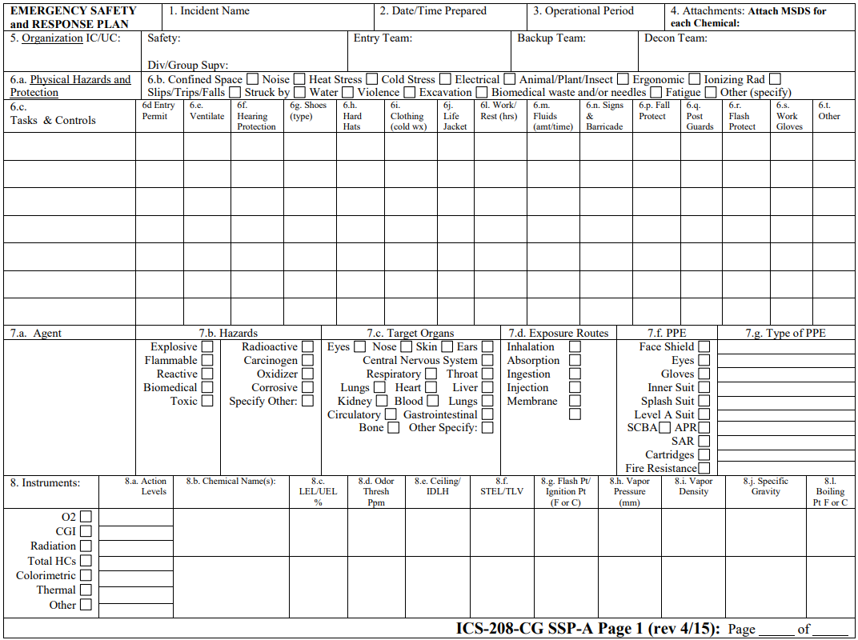
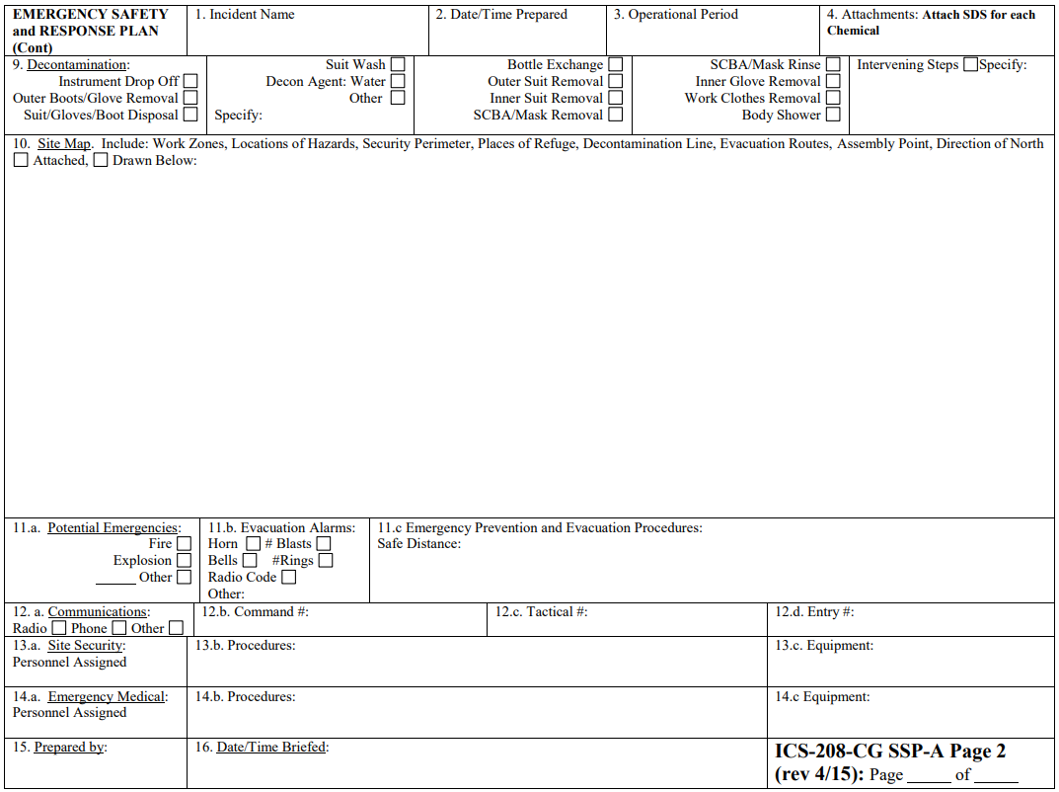
ICS 208 CG SSP-A:
Emergency Safety and Response
Notes:
Purpose: The Emergency Safety and Response Plan provides the Safety Officer and ICS personnel a plan for safeguarding personnel during the initial emergency phase of the response. It is only used during the emergency phase of the response, which is defined as a situation involving an uncontrolled release. It is also intended to meet the requirements of the Hazardous Waste Operations and Emergency Response (HAZWOPER) regulation, Title 29 Code of Federal Regulations Part 1910.120.

Slide 29
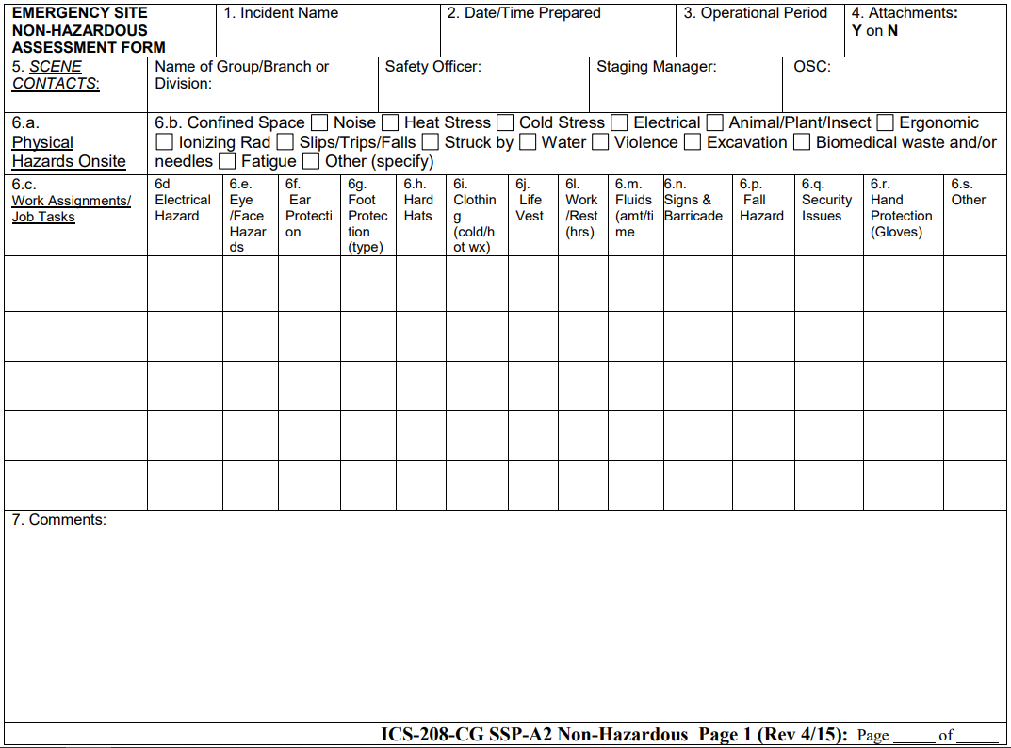
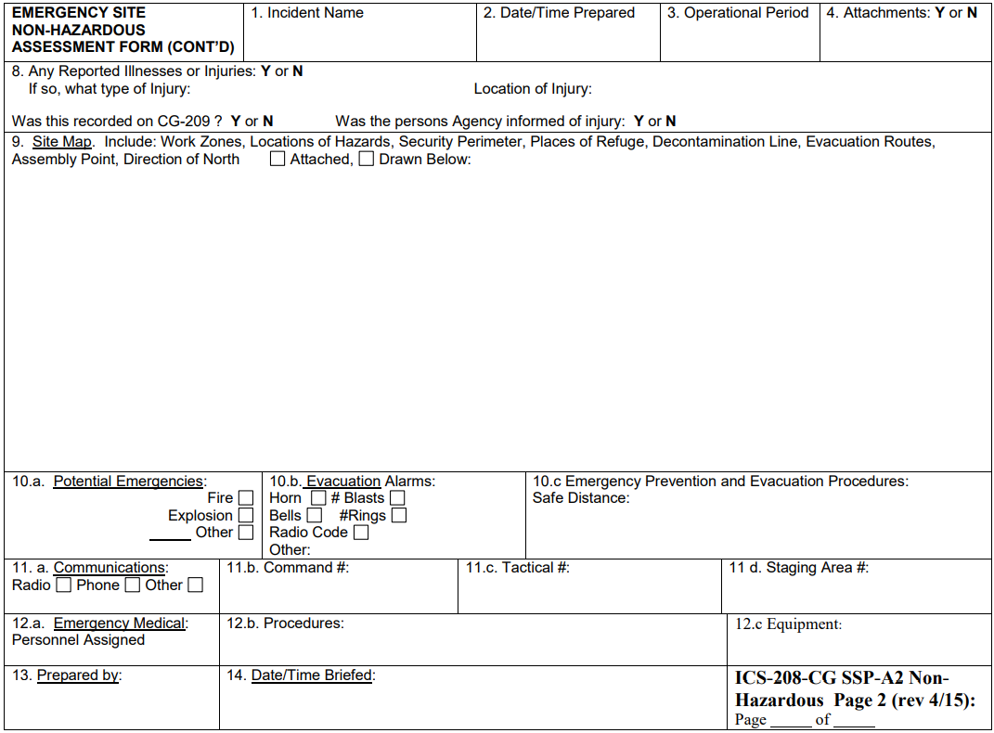
ICS 208 CG SSP-A2: Emergency Site Non-Hazardous Assessment Forms
Notes:
Purpose: The Emergency Site Non-Hazard Assessment Form provides the Safety Officer and ICS personnel a plan for safeguarding personnel during the initial emergency phase of the response when an uncontrolled release is NOT present. It is also intended to meet the requirements of the Hazardous Waste Operations and Emergency Response (HAZWOPER) regulation, Title 29 Code of Federal Regulations Part 1910.120.

Slide 30
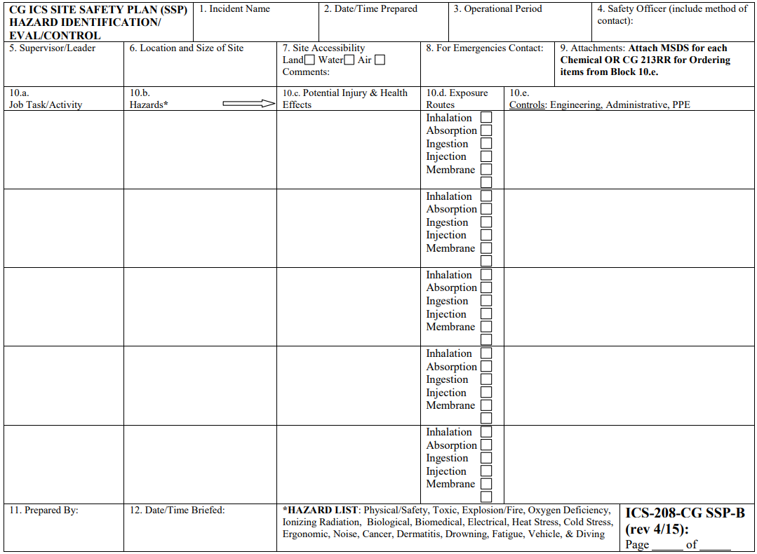
ICS 208 CG SSP-B: Site Safety Plan
Hazard Identification/Eval/Control
Notes:
The Site Safety Plan provides the Safety Officer and ICS personnel a plan for safeguarding personnel during the post-emergency phase of an incident. The post-emergency phase is when the situation is stabilized and cleanup operations have begun. ICS-208-CG SSP-B is intended to meet the requirements of the Hazardous Waste Operations and Emergency Response (HAZWOPER) regulation, Title 29 Code of Federal Regulations Part 1910.120.

Slide 31
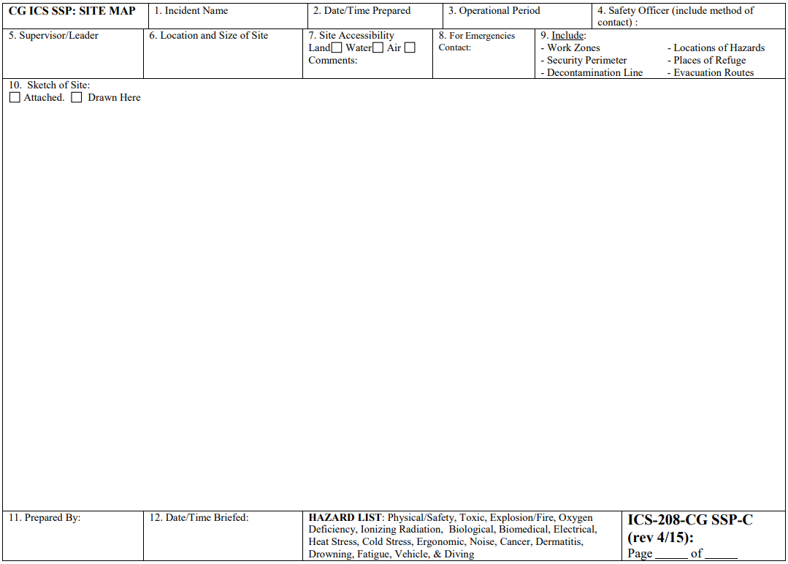
ICS 208 CG SSP-C:
Site Map
Notes:
Purpose: The Site Map for the Site Safety Plan is required by Title 29 Code of Federal Regulations Part 1910.120. It provides in 1 place a visual description of the site which can help ICS personnel locate hazards, identify evacuation routes and places of refuge.

Slide 32
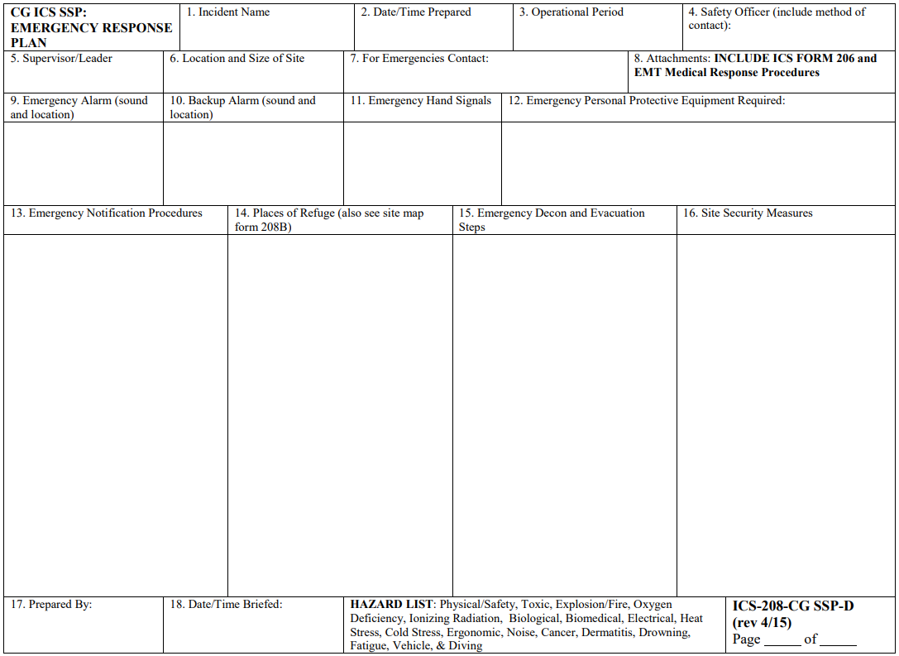
ICS 208 CG SSP-D:
Emergency Response Plan
Notes:
Purpose: The Emergency Response Plan provides information on measures to be taken in the event of an emergency. It is used in conjunction with the Site Safety Plan (Form ICS-208-CG SSP-B). It is also required by Title 29 Code of Federal Regulations Part 1910.120.

Slide 33
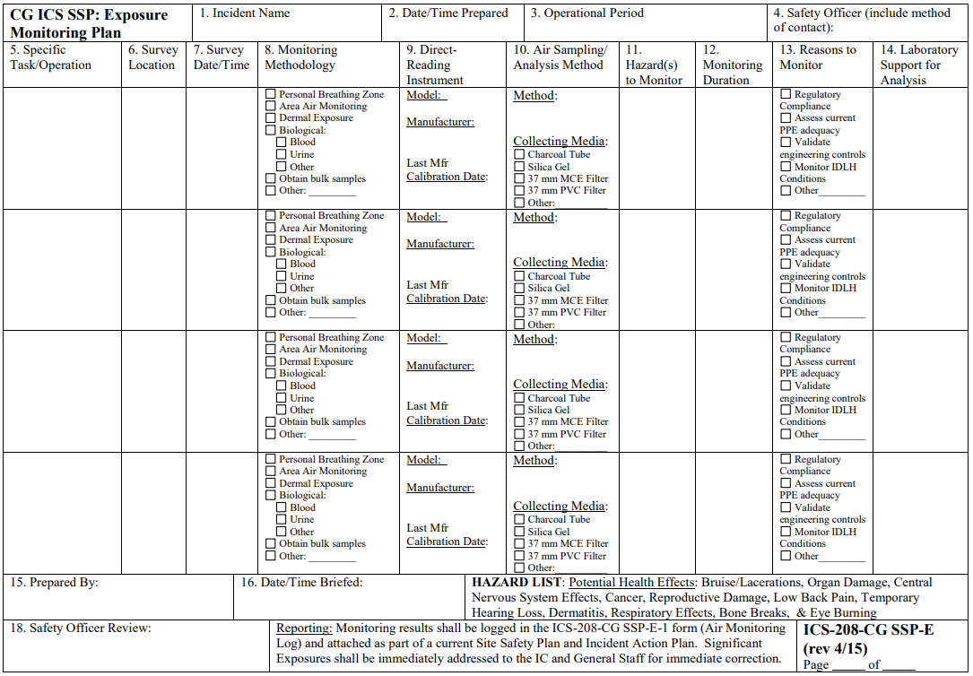
ICS 208 CG SSP-E:
Exposure Monitoring Plan
Notes:
Purpose: The Exposure Monitoring Plan provides plan of monitoring conducted during an incident. The plan is a supplement to the Site Safety Plan (ICS-208-CG SSP-B). It is only required when performing monitoring operations.

Slide 34
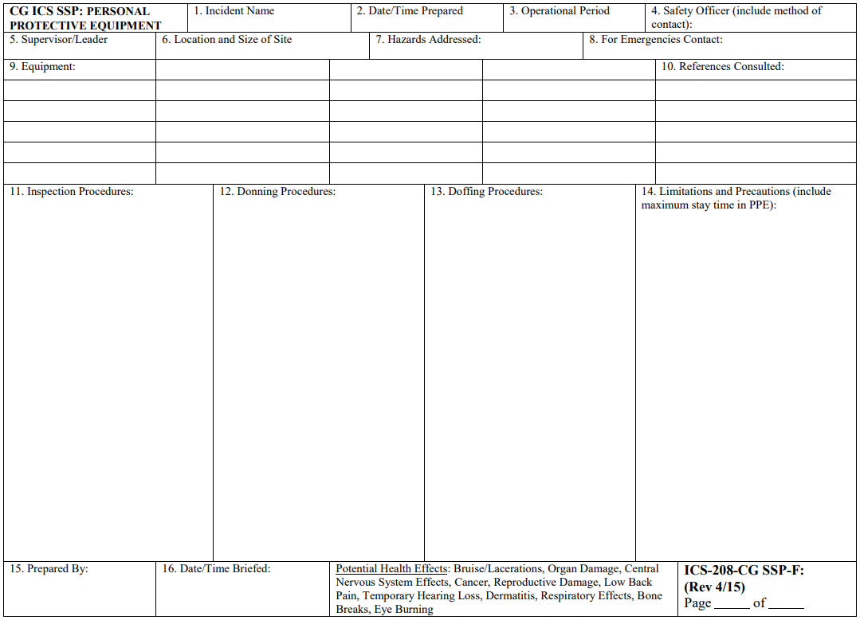
ICS 208 CG SSP-F:
Personal Protective Equipment
Notes:
Purpose: The Personal Protective Equipment form is a list of personal protective equipment to be used in operations. The listing of personal protective equipment is required by Title 29 Code of Federal Regulations Part 1910.120.

Slide 35
Safety Messages
Elements for the General Safety Message
Incident Name and Operational Period
Overall quick hitting message
More detailed safety information
Easy to Read, Organized Logically
Signed by Safety Officer
Posted at all Incident locations An example is provided on the next page.
ICS 204 Block 8: Special Instructions (examples)
MAINTAIN SITUATIONAL AWARENESS AT ALL TIMES.
Be mindful of slips trips and falls.
Remain hydrated, wear sunscreen, watch for environmental hazards (wildlife, insects, etc.).
Advise Safety Officer of all MISHAPs, injuries/illnesses.
MISHAPs should be reported on the ICS 237 MISHAP form.
All responders shall wear appropriate PPE for equipment utilized.
All personnel are to sign the Site Safety & Health Plan prior to going on shift.
Follow guidelines set forth in the ICS 208 Site Safety and Health Plan.
Notes:
The Overall Safety Message should be on a one-page sheet, is usually colored in a bright red or yellow (to draw attention to it) and should emphasize the top safety priorities and safeguards for the incident.
It is optional, used primarily to provide additional emphasis on a serious safety issue.
The message should be short and in bullet form for easy reading.
This message contains the most important safety information to communicate to Operations and its subordinate units.
FEMA ICS 208 is a SAFETY MESSAGE
CG ICS 208 is SITE SAFETY PLAN

Slide 36
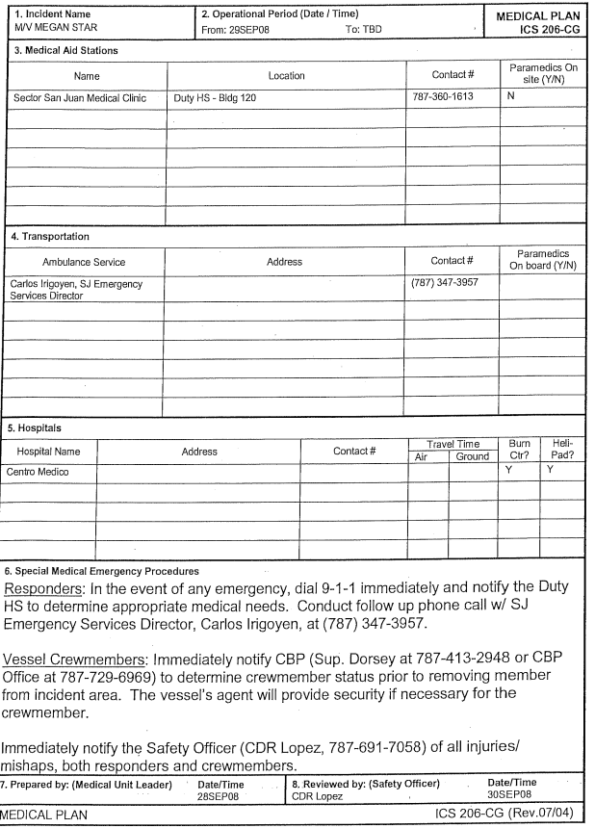
ICS 206: Medical Plan
The Safety Officer should evaluate the Medical Plan.
Is the information detailed enough to facilitate getting medical care to responders when required?
Are the identified medical facilities capable of providing needed care in a timely manner?
Is there a clear line of communication identified in the Medical Plan?
Is the location and capability of each medical facility clearly described within the plan?
Are the medical emergency reporting procedures clear?
Is there clear information if a Medevac is required? (How are we going to get someone out, triage, treat and transport them)
Where are the aid stations?
Where are the ambulances and are they in the right locations?
Are Helispots identified?
Can hospital/transport handle contaminated patients (do the patients need decontamination prior to transport)?
Notes:
ICS 206 is prepared by the Medical Unit Leader. If none assigned, it is up to Logistics Section Chief and the Safety Officer to negotiate completion and ownership of the form. If no SOFR assigned – IC and LSC will decide. Some versions of the form the Safety Officer signs the form.
ICS-206: Medical Plan – provides information on incident medical aid stations, medical transportation, hospital, and medical emergency procedures for response resources
Purpose: The Medical Plan (ICS-206) provides information on incident medical aid stations, transportation services, hospitals, and medical emergency procedures primarily for incident response resources.
Preparation: The ICS-206 is prepared by the Logistics Section and reviewed by the Safety Officer to ensure ICS coordination. If aviation assets are used for rescue, coordination with the Air Operations branch is required.
Distribution: The ICS-206 is part of the IAP. All completed forms must be given to the Documentation Unit in the Planning Section.
The Safety Officer should evaluate the Medical Plan.
Is the information detailed enough to facilitate getting medical care to responders when required?
Are the identified medical facilities capable of providing needed care in a timely manner?
Is there a clear line of communication identified in the Medical Plan?
Is the location and capability of each medical facility clearly described within the plan?
Are the medical emergency reporting procedures clear?
Is there clear information if a Medevac is required? (How are we going to get someone out, triage, treat and transport them)
Where are the aid stations?
Where are the ambulances and are they in the right locations?
Are Helispots identified?
Can hospital/transport handle contaminated patients (do the patients need decontamination prior to transport)?

Slide 37
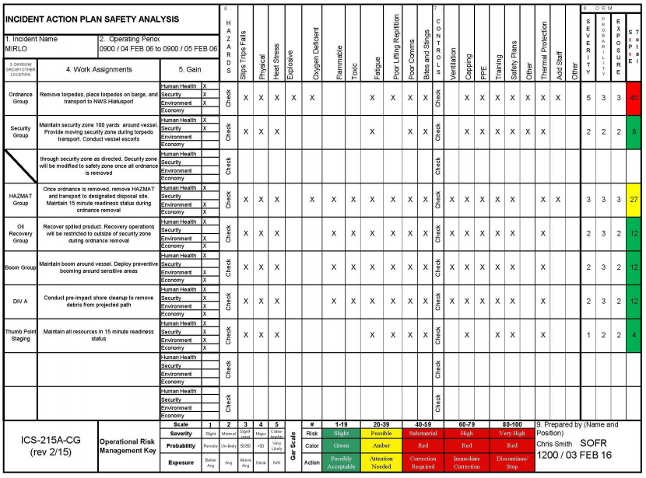
ICS 215A: Incident Action Plan Safety Analysis
Notes:
ICS-215A Incident Action Plan Safety Analysis form is used to:
Produce an operational risk assessment in order to prioritize hazards, safety, and health issues, and develop appropriate control
Enable Command and General staff to form a complete picture in anticipation of planned operational activities
Purpose: The purpose of the Incident Action Plan Safety Analysis (ICS‑215A) is to aid the Safety Officer in completing an operational risk assessment to prioritize hazard, safety, and health issues, and to develop appropriate mitigations. This worksheet is best used in the planning phase to identify safety concerns for all operational assignments.
Preparation: The ICS-215A is typically prepared by the Safety Officer during the incident action planning cycle. When the Operations Section Chief is preparing for the Tactics Meeting, the Safety Officer collaborates with the Operations Section Chief to complete the form. This form is closely linked to the Operational Planning Worksheet (ICS-215).
Distribution: When the safety analysis is completed, the form is distributed to the Resources Unit to help prepare ICS-204 forms for each Branch, Division, and Group. All completed forms must be given to the Documentation Unit in the Planning Section.

Slide 38


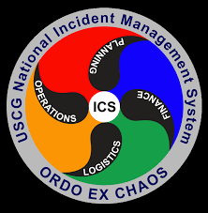
Round table
Questions?
Discussion
Thank you for your participation

Slide 39
Additional Sessions
All positions
Operations section
Planning section
Logistics & finance sections
PAC-3IM Reserve IMAT | Planning Team

